Slide 1




How do we make explainable AI work for people?
Bálint Gyevnár
25 April 2024
In Machine Learning and Modelling Seminar Series at Charles University of Prague
Autonomous Agents
Research Group

Slide 2
AGENDA
What are the fundamental problems with current explainable AI (XAI)?
How to operationalise better explanations for AI-based decision-making?

Slide 3
INTRO – A FIRE IN THE FOREST
Setup:
You are hiking in a forest. In the evening you make a fire to cook food.
Question:
Why is the fire burning?
Answers A:
For cooking food.
Because I collected firewood and lit them with a lighter.
Answers B:
Because firewood is flammable.
Because the moisture content of the firewood was low.
Example based on:
[1] Quillien, T., & Lucas, C. G. (2023, June 8). Counterfactuals and the Logic of Causal Selection. Psychological Review. Advance online publication. https://dx.doi.org/10.1037/rev0000428

Slide 4

INTRO – A FIRE IN THE FOREST
Setup:
You are hiking in a forest. In the evening you make a fire to cook food.
Question:
Why is the fire burning?
Answers A:
For cooking food.
Because I collected firewood and lit them with a lighter.
Answers B (XAI version):
Concentration of carbon had an importance of 19.84.
Water content in firewood had an importance of 13.37.
Example based on:
[1] Quillien, T., & Lucas, C. G. (2023, June 8). Counterfactuals and the Logic of Causal Selection. Psychological Review. Advance online publication. https://dx.doi.org/10.1037/rev0000428

Slide 5
PROBLEMS – A FIRE IN THE FOREST
Requires:
Domain knowledge
Model understanding
Lacks:
Causality
Interventions
Counterfactuals
Teleology
Recourse
Intelligibility
Detailed background:
What is carbon concentration?
How is water content defined?
What are the units/scale of these numbers?
How has the model arrived at its decision?
Actionability or recourse:
What is the relationship between features?
What happens if I change the features?
What if things had been different?
What is the purpose of the fire burning?
How do I make the fire stop burning?
Can stakeholders understand the explanation?

Slide 6

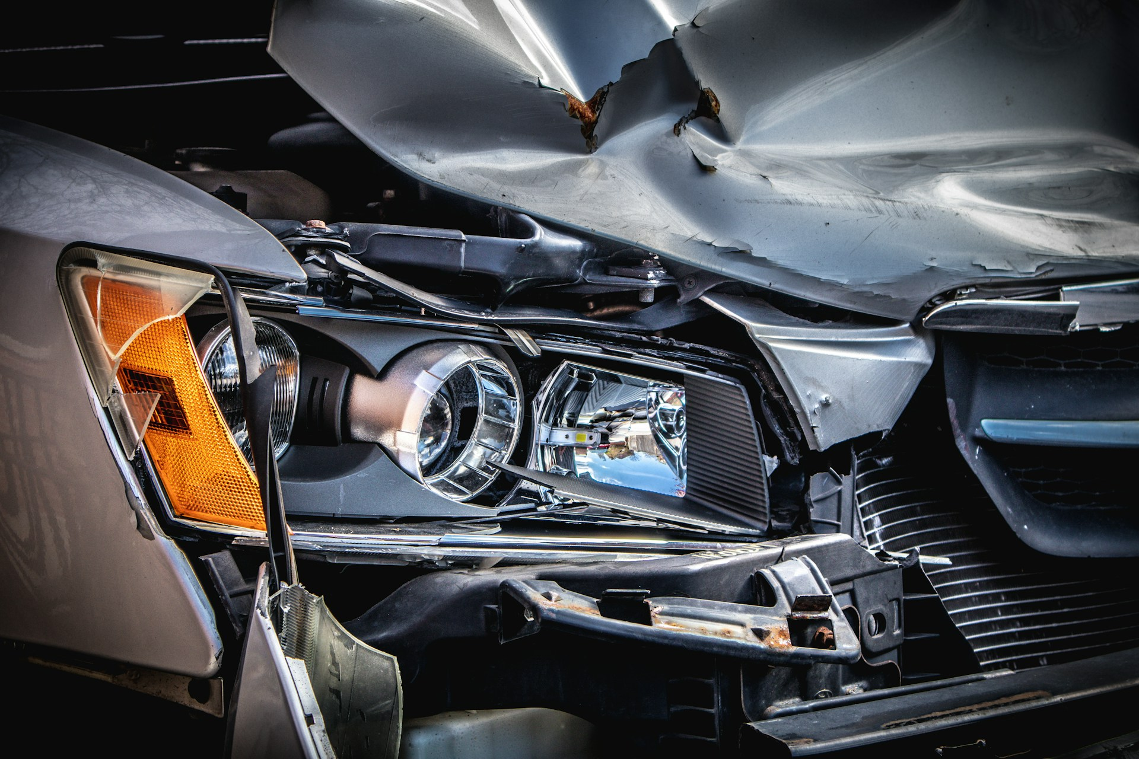

SOCIALLY/EPISTEMICALLY/SAFETY-CRITICAL SYSTEMS
Safety critical systems are not so forgiving as burning wood in a forest.
Medical diagnoses
Autonomous vehicles
Care robots
Photo by National Cancer Institute on Unsplash
Photo by Clark Van Der Beken on Unsplash
Photo by Possessed Photography on Unsplash
Also: manufacturing, power grids, disaster prediction, search & rescue, etc.
Can people trust and rely on XAI for these applications? NO.

Slide 7

DISCLAIMER – FOCUS ON CLASSICAL XAI
Explainable AI
Classical XAI
Human-centric XAI
SHAP
Attention
Evaluative AI [2]
LIME
$$∅?$$
Talk2Model [3]
Saliency
map
Counterfactual
examples
CEMA [4]
Ante-hoc methods
[2] Miller, T. (2023). Explainable AI is Dead, Long Live Explainable AI! Hypothesis-driven Decision Support using Evaluative AI. Proceedings of the 2023 ACM Conference on Fairness, Accountability, and Transparency, 333–342.
[3] Slack, D., Krishna, S., Lakkaraju, H., & Singh, S. (2023). Explaining machine learning models with interactive natural language conversations using TalkToModel. Nature Machine Intelligence, 5(8), Article 8.
[4] Gyevnar, B., Wang, C., Lucas, C. G., Cohen, S. B., & Albrecht, S. V. (2024). Causal Explanations for Sequential Decision-Making in Multi-Agent Systems. In The 23rd International Conference on Autonomous Agents and Multi-Agent Systems (AAMAS 2024).

Slide 8
AGENDA
What are the fundamental problems with current explainable AI (XAI)?
  Motivation for XAI is misplaced;
How to operationalise better explanations for AI-based decision-making?

Slide 9
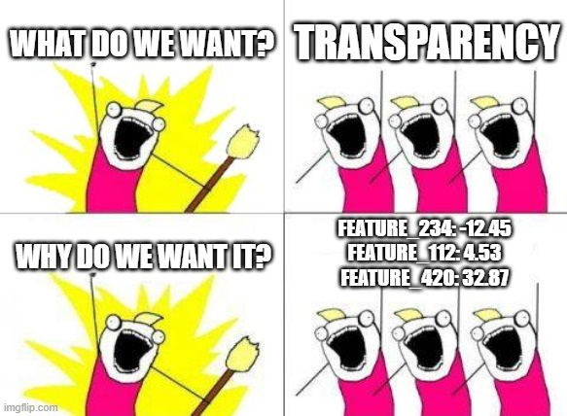
MOTIVATION FOR XAI IS MISPLACED
Big piece of the motivation:
Achieve transparency for the AI system
Why do we want transparency?
Trust, public acceptance, understanding, etc.
How do we achieve transparency?
Classical XAI?

Slide 10
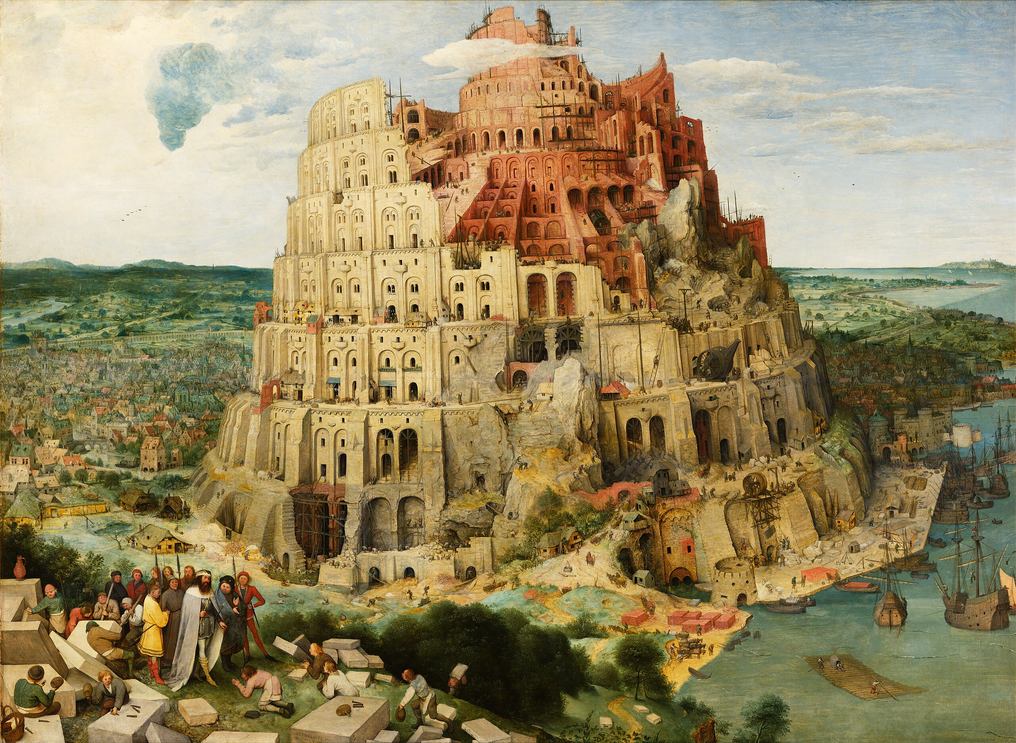
TOWER OF BABEL OF XAI – THE PROBLEM
The Tower of Babel of XAI [7]:
Ethics guidelines;
Law (e.g., GDPR, AIA, DSA);
Standards;
Computer science.
Confusing and interchanging terminology:
Slows down progress and communication
The Tower of Babel by Pieter Bruegel the Elder (1563)
[8] Schneeberger, D., Röttger, R., Cabitza, F., Campagner, A., Plass, M., Müller, H., & Holzinger, A. (2023). The Tower of Babel in Explainable Artificial Intelligence (XAI). In Machine Learning and Knowledge Extraction (pp. 65–81). Springer Nature Switzerland. https://doi.org/10.1007/978-3-031-40837-3_5

Slide 11
TOWER BABEL OF XAI – PROPOSED SOLUTION
Term | Type | Target | Example
Transparent | Emergent | Ecosystem | XAI + user manual
Explainable | Emergent | System | XAI
Interpretable | Inherent | Model | Shallow decision tree
Justifiable | Emergent | Decision | Loan prediction
[5] Gyevnar, B., Ferguson, N., & Schafer, B. (2023). Bridging the transparency gap: What can explainable AI learn from the AI Act? In Proceedings of ECAI 2023, the 26th European Conference on Artificial Intelligence (pp. 964 - 971). https://doi.org/10.3233/FAIA230367

Slide 12
TRANSPARENCY AS AN END
Classical XAI = AI system + Explanation
Classical XAI = ML classification + Post-hoc rationalisation
E.g., SVM + SHAP
The End
implies
Transparency = Explanation
[5] Gyevnar, B., Ferguson, N., & Schafer, B. (2023). Bridging the transparency gap: What can explainable AI learn from the AI Act? In Proceedings of ECAI 2023, the 26th European Conference on Artificial Intelligence (pp. 964 - 971). https://doi.org/10.3233/FAIA230367

Slide 13
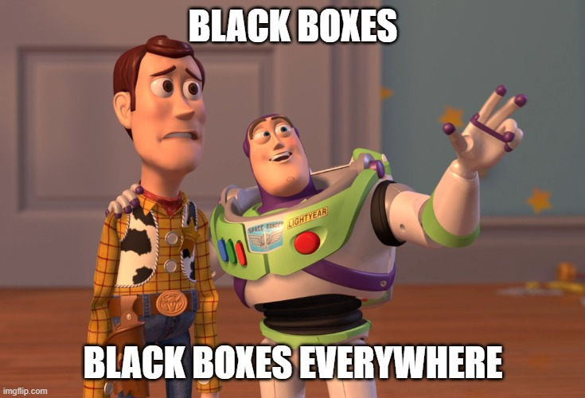
BLIND RELIANCE ON BLACK-BOX AI
Black boxes where none belong:
Critical decision-making affecting lives;
Classical XAI is approximation:
Causal chain is not (well) represented;
Assumes black box is always right:
Classical XAI can mislead by justifying incorrect decisions;
More complex decision process:
Now need to debug two systems (AI + XAI).
[6] Rudin, C. (2019). Stop explaining black box machine learning models for high stakes decisions and use interpretable models instead. Nature Machine Intelligence, 1(5), Article 5. https://doi.org/10.1038/s42256-019-0048-x

Slide 14
UNACTIONABLE EXPLANATIONS
Classical XAI generates unactionable explanations:
Explanations pick features that are hard to change;
For example:
“You could have received the loan if only you were 185cm tall.”
“Your marital status had the most effect on your recidivism chance.”
[7] Ustun, B., Spangher, A., & Liu, Y. (2019). Actionable Recourse in Linear Classification. Proceedings of the Conference on Fairness, Accountability, and Transparency, 10–19. https://doi.org/10.1145/3287560.3287566

Slide 15
TRANSPARENCY AS A MEANS
XAI = AI system + Explanation + Context
Context: stakeholders, communication, deployment lifecycle, model updates, recourse, etc.
A means
Transparency = Explanation + documentation + standardisation + risk assessment + …
[5] Gyevnar, B., Ferguson, N., & Schafer, B. (2023). Bridging the transparency gap: What can explainable AI learn from the AI Act? In Proceedings of ECAI 2023, the 26th European Conference on Artificial Intelligence (pp. 964 - 971). https://doi.org/10.3233/FAIA230367

Slide 16
MOTIVATION FOR XAI IS MISPLACED
This is nothing new in legal contexts:
Law is always interpreted in context;
In law, transparency itself is a means towards:
Protection of Human Rights;
Sustainable innovation.
[5] Gyevnar, B., Ferguson, N., & Schafer, B. (2023). Bridging the transparency gap: What can explainable AI learn from the AI Act? In Proceedings of ECAI 2023, the 26th European Conference on Artificial Intelligence (pp. 964 - 971). https://doi.org/10.3233/FAIA230367

Slide 17
THE TRANSPARENCY GAP
TRANSPARENCY GAP
Transparency as an end
“The post-hoc rationalisation of post-hoc rationalisations”
Transparency as a means
“Explanations should serve the user not the creator”
Blindly applying XAI methods to ML systems hurts the overall system.
[5] Gyevnar, B., Ferguson, N., & Schafer, B. (2023). Bridging the transparency gap: What can explainable AI learn from the AI Act? In Proceedings of ECAI 2023, the 26th European Conference on Artificial Intelligence (pp. 964 - 971). https://doi.org/10.3233/FAIA230367

Slide 18
TRANSPARENCY DESIGN CHECKLIST
Design checklist:
Who will be using the system and where?
What effects can the AI decision have on the user?
How does the Explanation affect the interpretation of the AI decision?
Does the XAI system change if the AI system changes?
Does the system handle distribution shifts and OOD examples?
What if the AI decision is wrong?
[5] Gyevnar, B., Ferguson, N., & Schafer, B. (2023). Bridging the transparency gap: What can explainable AI learn from the AI Act? In Proceedings of ECAI 2023, the 26th European Conference on Artificial Intelligence (pp. 964 - 971). https://doi.org/10.3233/FAIA230367

Slide 19
AGENDA
What are the fundamental problems with current explainable AI (XAI)?
  Motivation for XAI is misplaced;
  Standard methods are unreliable;
How to operationalise better explanations for AI-based decision-making?

Slide 20
UNRELIABLE XAI
Four examples:
Misusing Shapley values
Misleading saliency maps
Inconsistent attention weights
Brittle counterfactuals

Slide 21
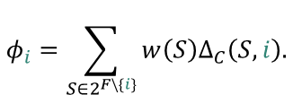



MISUSING SHAPLEY VALUES
Shapley values:
A method to calculate item value based on average marginal contributions;
Marginal gain from using item $i$with cost function $C:$
$$Δ_{C}\left(S,i\right)=C\left(S∪\left\{i\right\}\right)−C\left(S\right);$$
$$φ_{i}=\sum_{S∈2^{F\backslash \{i\}}}{w\left(S\right)Δ_{C}\left(S, i\right).}$$
Average contribution of item $i:$
[9] Fryer, D., Strümke, I., & Nguyen, H. (2021). Shapley Values for Feature Selection: The Good, the Bad, and the Axioms. IEEE Access, 9, 144352–144360. https://doi.org/10.1109/ACCESS.2021.3119110

Slide 22
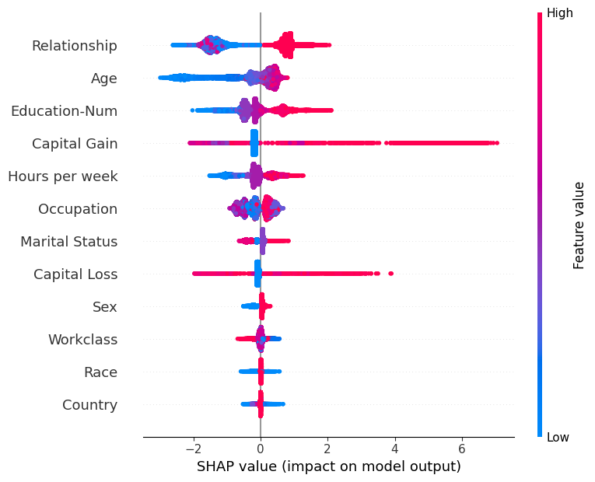
MISUSING SHAPLEY VALUES
Example taken from SHAP documentation.
[9] Fryer, D., Strümke, I., & Nguyen, H. (2021). Shapley Values for Feature Selection: The Good, the Bad, and the Axioms. IEEE Access, 9, 144352–144360. https://doi.org/10.1109/ACCESS.2021.3119110

Slide 23
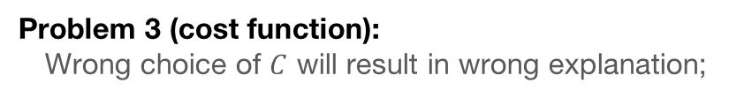
MISUSING SHAPLEY VALUES
Problem 1 (transparency gap):
Not specifically designed for ML feature selection;
Naïvely applying to ML feature selection introduces Problem 2 – 4;
Problem 2 (model averaging):
Redundant features are assigned non-zero influence;
Problem 3 (cost function):
Wrong choice of $C$ will result in wrong explanation;
Problem 4 (correlated features):
Correlated features are assigned similar value though one may be redundant.
[9] Fryer, D., Strümke, I., & Nguyen, H. (2021). Shapley Values for Feature Selection: The Good, the Bad, and the Axioms. IEEE Access, 9, 144352–144360. https://doi.org/10.1109/ACCESS.2021.3119110

Slide 24
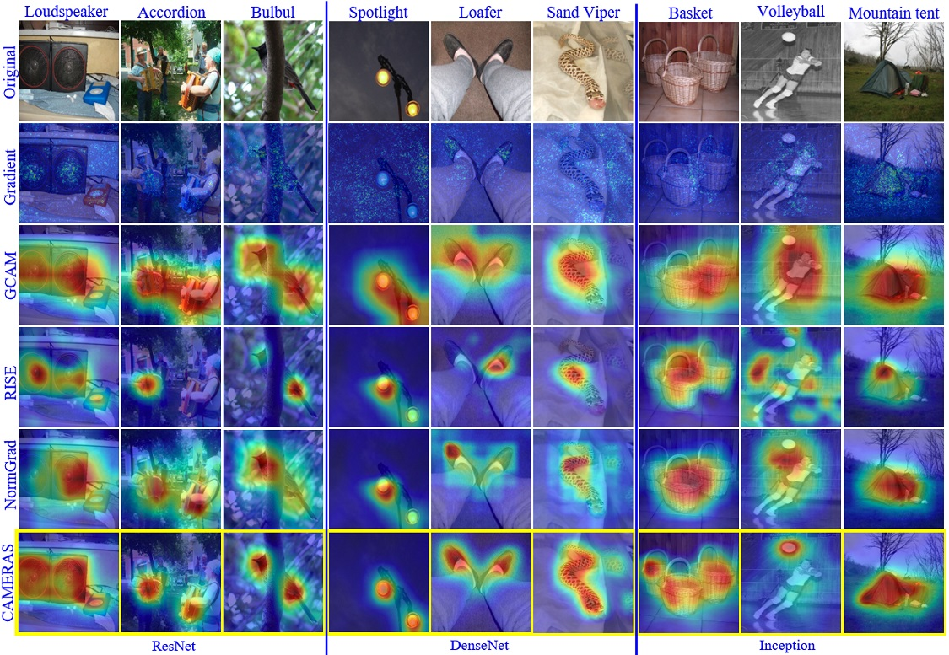
HIGHLIGHTING MISLEADING SALIENCY MAPS
Saliency maps:
Feature importance for high-dimensional inputs;
Adversarial attacks:
Keep output same with different saliency map.
Arbitrary and cherry-picked interpretations:
Saliency maps are difficult to interpret;
Interpretations can be irrelevant.
Figure from Jalwana et al. [11].
[10] Adebayo, J., Gilmer, J., Muelly, M., Goodfellow, I., Hardt, M., & Kim, B. (2020). Sanity Checks for Saliency Maps (arXiv:1810.03292). arXiv.1810.03292 https://doi.org/10.48550/arXiv.1810.03292
[11]. Jalwana, M. A. A. K., Akhtar, N., Bennamoun, M., & Mian, A. (2021). CAMERAS: Enhanced Resolution And Sanity preserving Class Activation Mapping for image saliency. 2021 IEEE/CVF Conference on Computer Vision and Pattern Recognition (CVPR), 16322–16331. https://doi.org/10.1109/CVPR46437.2021.01606

Slide 25
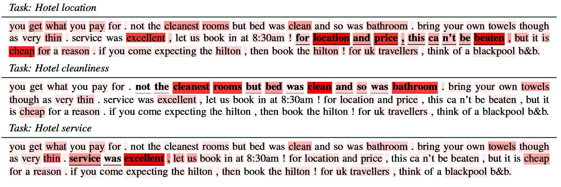
ATTENTION IS NOT (NOT) EXPLANATION
Attention weights learnt by the model:
Intuitively, makes sense as a form of plausible explanations;
Figure by Galassi et al. [12]
[12] Galassi, A., Lippi, M., & Torroni, P. (2021). Attention in Natural Language Processing. IEEE Transactions on Neural Networks and Learning Systems, 32(10), 4291–4308. https://doi.org/10.1109/TNNLS.2020.3019893

Slide 26
ATTENTION IS NOT (NOT) EXPLANATION
Attention weights can be attacked:
Adversarial attacks change weights but keep decision same;
Plausible explanations may be unfaithful:
Misleading users completely;
Attention weights can contradict saliency measures:
Which one do we trust?
[12] Jain, S., & Wallace, B. C. (2019). Attention is not Explanation. In J. Burstein, C. Doran, & T. Solorio (Eds.), Proceedings of the 2019 Conference of the North American Chapter of the Association for Computational Linguistics: Human Language Technologies, Volume 1 (Long and Short Papers) (pp. 3543–3556). Association for Computational Linguistics. https://doi.org/10.18653/v1/N19-1357
[13] Wiegreffe, S., & Pinter, Y. (2019). Attention is not not Explanation. In K. Inui, J. Jiang, V. Ng, & X. Wan (Eds.), Proceedings of the 2019 Conference on Empirical Methods in Natural Language Processing and the 9th International Joint Conference on Natural Language Processing (EMNLP-IJCNLP) (pp. 11–20). Association for Computational Linguistics. https://doi.org/10.18653/v1/D19-1002

Slide 27
BRITTLE COUNTERFACTUALS
Brittle explanations:
A small change in input leads to different CE;
c
c'
Sensitive to distance metric:
Different metrics also have different interpretations;
x
x'
x"
c"
CE can function as adversarial examples:
Possible to game the system with information of CE.
Figure 1 reproduced from Leofante & Potyka [14]. Teal circle represents the decision boundary in a binary classification setting.
[7] Ustun, B., Spangher, A., & Liu, Y. (2019). Actionable Recourse in Linear Classification. Proceedings of the Conference on Fairness, Accountability, and Transparency, 10–19. https://doi.org/10.1145/3287560.3287566
[14] Leofante, F., & Potyka, N. (2024). Promoting Counterfactual Robustness through Diversity. Proceedings of the AAAI Conference on Artificial Intelligence, 38(19), Article 19. https://doi.org/10.1609/aaai.v38i19.30127

Slide 28

USE WITH CARE
This is not to say that we should never use
these methods. But:
Need to be very careful when applying them;
Use critical thinking and know the limits of the method;
Don’t just shove XAI at everything;
Use meaningful evaluation.

Slide 29
AGENDA
What are the fundamental problems with current explainable AI (XAI)?
  Motivation for XAI is misplaced;
  Standard methods are unreliable;
  XAI evaluation is flawed;
How to operationalise better explanations for AI-based decision-making?

Slide 30
ISSUES OF EVALUATION
Evaluation in XAI is flawed:
Not having a strong motivation for evaluation;
Quantitative evaluation is ill-posed;
Lack of qualitative evaluation;
User studies are badly designed.

Slide 31
WHY DO WE EVALUATE?
Ask the question: what is the purpose of my evaluating XAI?
Often missing a strong motivation:
Results from the transparency gap;
Explanation for the sake of explanation cannot be meaningfully evaluated;
Motivation and evaluation is not compatible:
Trust, transparency, etc. often mentioned as motivation;
These must not just be lofty long-distance goals;

Slide 32
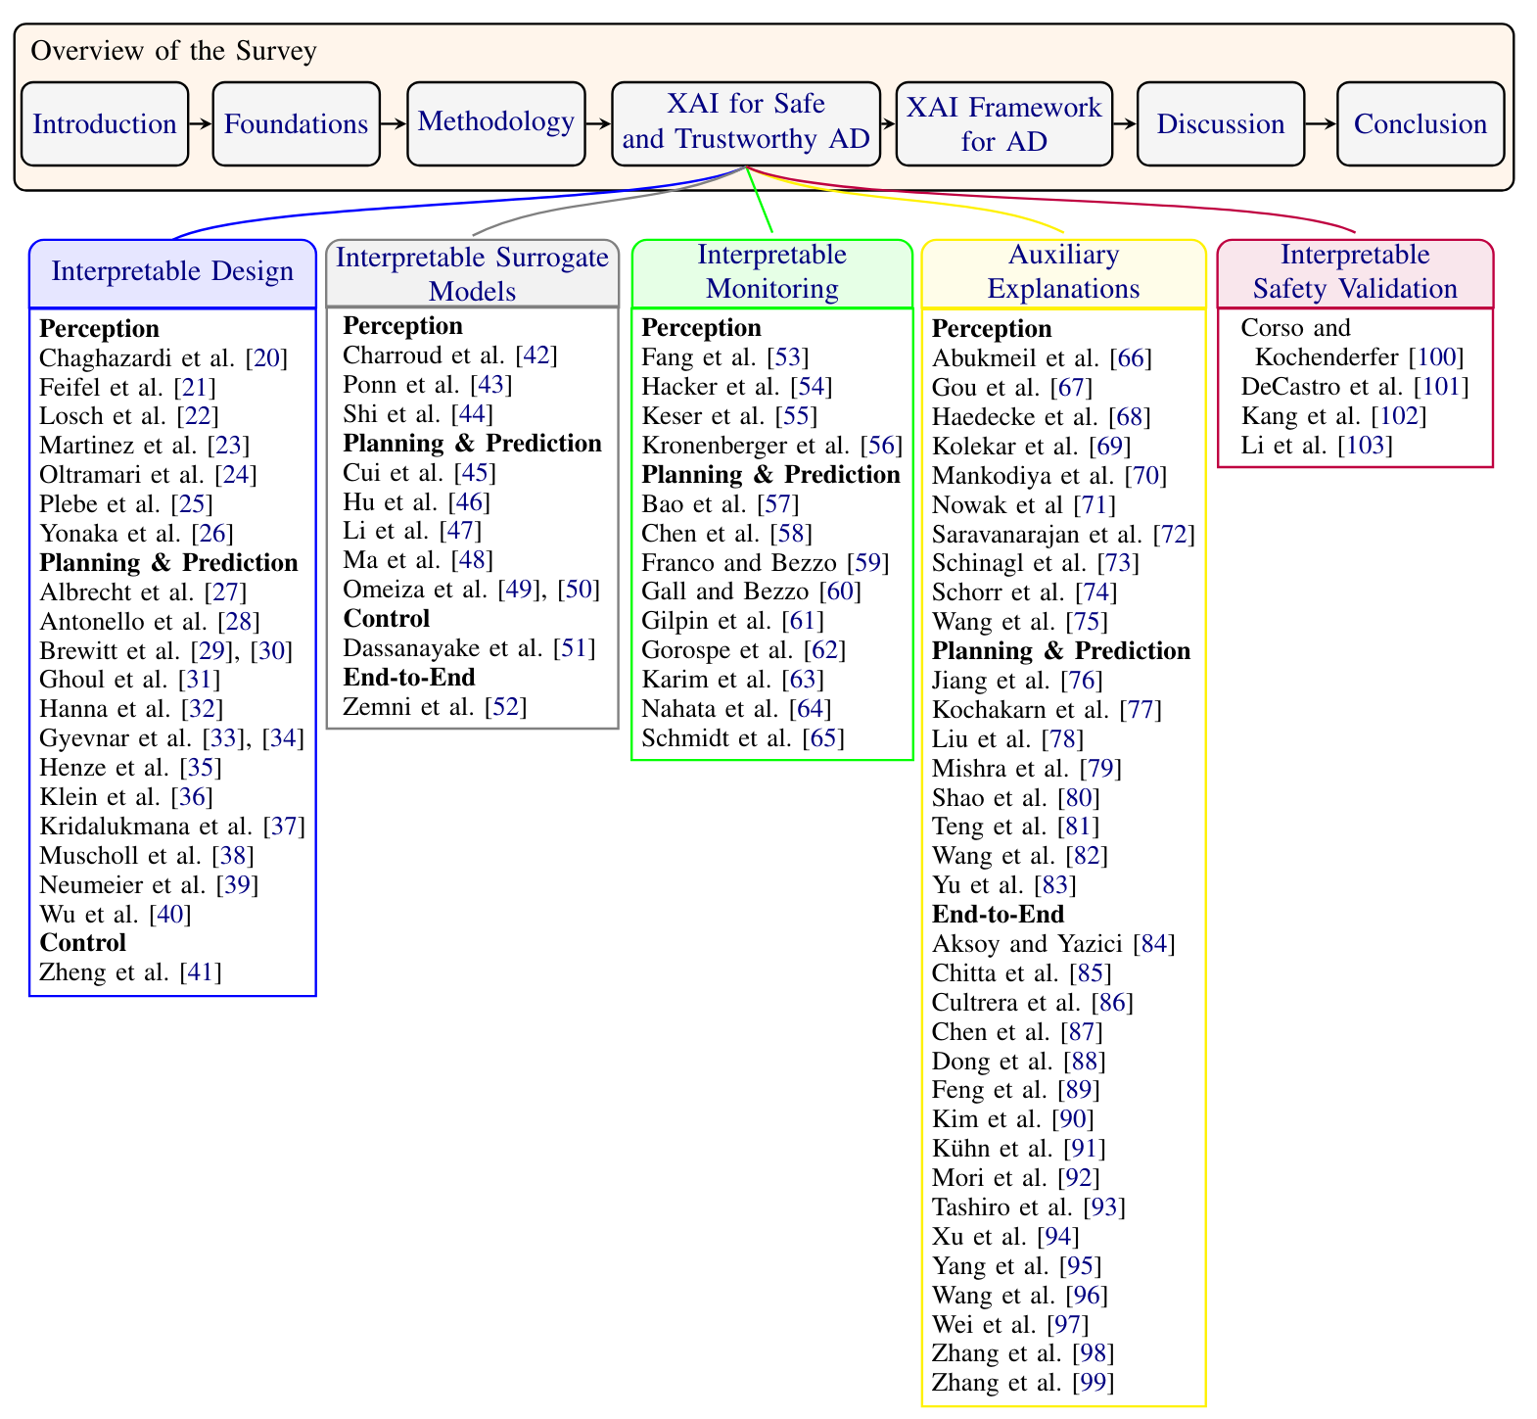
WHY DO WE EVALUATE?
Example: Recent review of XAI for autonomous driving
Majority of methods are “auxiliary explanations”;
XAI (almost always) functions as an afterthought;
Usually, the process goes:
Take existing computational problem (e.g., object detection, intention prediction);
Train some novel model with some appendix layer;
Get better number and interpret results;
Write about importance of transparency in intro.
[15] Kuznietsov, A., Gyevnar, B., Wang, C., Peters, S., & Albrecht, S. V. (2024). Explainable AI for Safe and Trustworthy Autonomous Driving: A Systematic Review (arXiv:2402.10086). arXiv. http://arxiv.org/abs/2402.10086

Slide 33
QUANTITATIVE EVALUATION IS ILL-POSED
What even is a correct explanation?
No such thing as a ground truth explanation:
Otherwise, we are just doing classification;
Fidelity:
Degree to which an explanation represents the decision-making process faithfully (but not necessarily completely);
Fidelity is NOT all you need:
You don’t need to explain all factors that affected the decision;
Different explanations work better for different people and contexts.

Slide 34
QUANTITATIVE EVALUATION IS ILL-POSED
Intelligibility:
Too complex explanations have high overhead;
Natural language is your friend;
Consistency:
Two explanations of the same decision in the same context should not contradict;
But it may change if context and/or listener changes;
Robustness:
Handle out-of-distribution decisions with bounds;
Handle domain shift;
Failure handling:
Calibrate user expectations;
Don’t just ignore/hide errors.

Slide 35
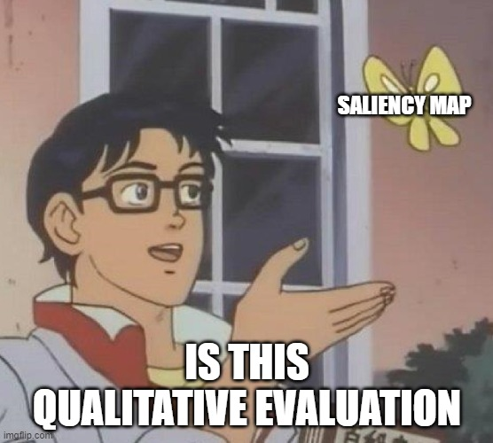
LACK OF QUALITATIVE EVALUATION
Many papers don’t have any qualitative evaluation:
Report accuracy and faithfulness metrics;
Or it is surface level:
Give an example of a saliency map for a single training instance;
Usually without focusing on failure cases.

Slide 36
LACK OF QUALITATIVE EVALUATION
Qualitative evaluation is essential to show:
System produces reasonable explanations;
Where and when the system fails;
Understand properties of your data.

Slide 37
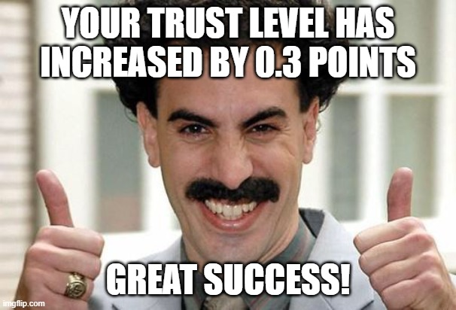
USER STUDIES ARE BADLY DESIGNED
User studies are standard practice;
Based on strong assumptions:
People need explanations;
People engage with explanations;
People understand domain;
With the wrong methods and goals:
Trust improvement;
Perceived quality and understanding;
One-shot testing.
[2] Miller, T. (2023). Explainable AI is Dead, Long Live Explainable AI! Hypothesis-driven Decision Support using Evaluative AI. Proceedings of the 2023 ACM Conference on Fairness, Accountability, and Transparency, 333–342.
[16] Miller, T. (2022). Are we measuring trust correctly in explainability, interpretability, and transparency research? (arXiv:2209.00651). arXiv. http://arxiv.org/abs/2209.00651

Slide 38
USER STUDIES CHECKLIST
Focus on calibrating trust:
According to the capabilities of the system;
User mustn’t blindly trust the system;
Use both subjective and objective measures:
Self-reporting and Likert-scales;
Observational measures (performance, reliance, failure prediction);
Perform iterative evaluation:
Build explanations incrementally;
Explanations alter mental models.

Slide 39
USER STUDIES ARE BADLY DESIGNED
Ask whether you need a user study in the first place:
Depends on stakeholders;
Don’t treat it as gospel;
Let people explore the model:
Propose hypotheses;
Interactive visualisations;
Think carefully about stakeholders:
Explanations don’t exist in a vacuum;
Remember the transparency gap.

Slide 40
To summarise so far…

Slide 41
AN AGENDA FOR BETTER XAI
Remember the transparency gap:
Explanations are a means to improve people’s lives not an end in themselves;
Tower of Babel of XAI. Use terms consistently;
Blind reliance on classical XAI methods;
Methods can be flawed. Use with care!
Strong assumptions about preference/cost functions;
Explanations can be brittle, inconsistent, or attacked;
Or just plain incorrect.
Evaluate for what you need to evaluate:
Strong motivation is essential;
Know you stakeholders;
What are your (in)dependent variables?

Slide 42
AGENDA
What are the fundamental problems with current explainable AI (XAI)?
  Motivation for XAI is misplaced;
  Standard methods are unreliable;
  XAI evaluation is unrevealing;
How to operationalise better explanations for AI-based decision-making?
  Multi-agent systems (MAS);

Slide 43
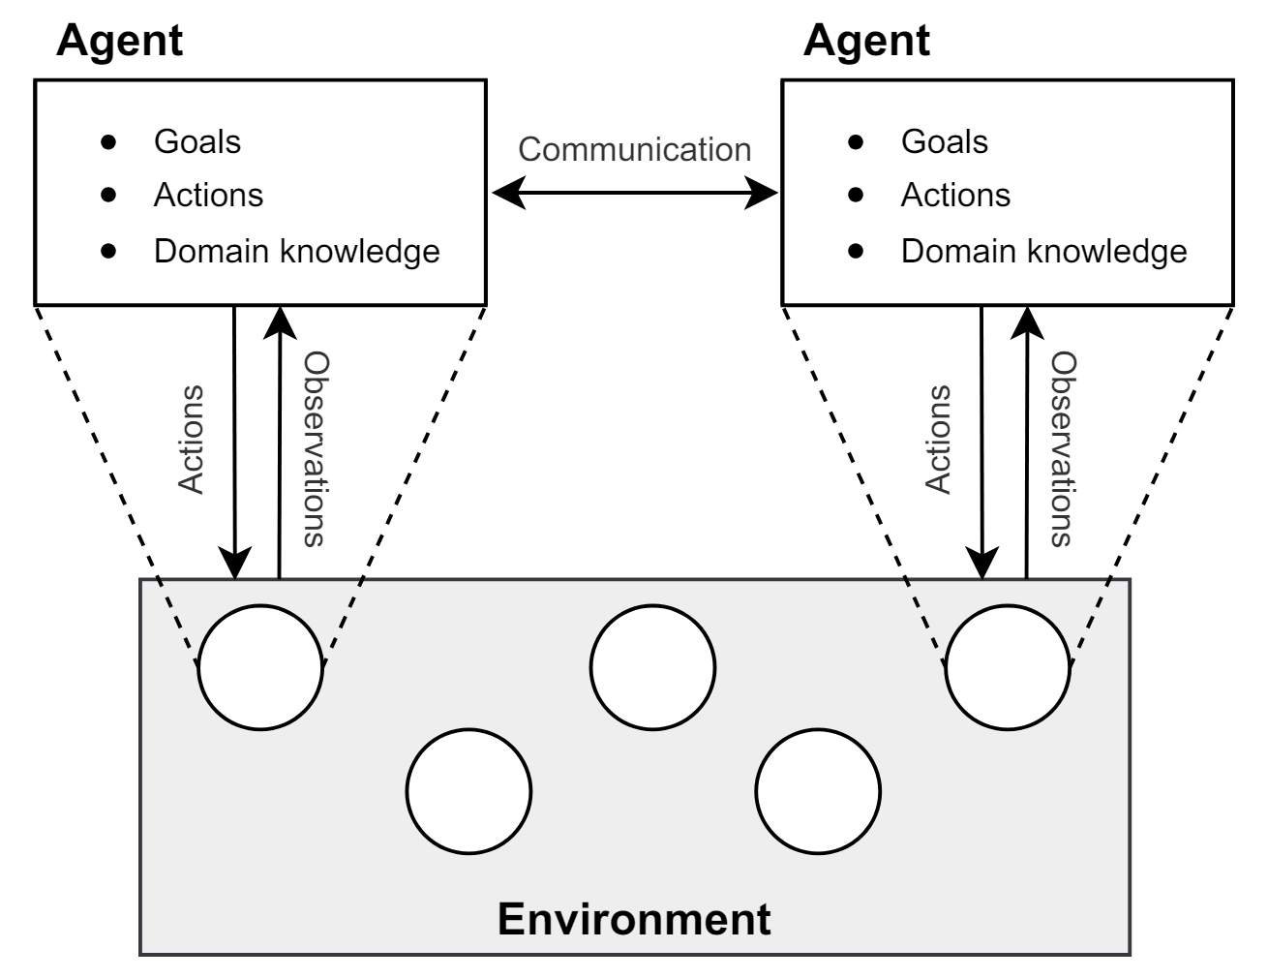
MULTI-AGENT SYSTEMS (MAS)
What is a multi-agent systems?
Environment (actions, observations, states);
Agents (goals, rewards, policies);
Communication;
E.g., autonomous driving;
Humans can be modelled as agents;
Explanation is multi-agent interaction:
Explainer: XAI agent
Explainee: Human
Action: Request explanation
Figure by Albrecht et al. [17].
[17] Albrecht, S. V., Christianos, F., & Schäfer, L. (2024). Multi-agent reinforcement learning: Foundations and modern approaches. MIT Press. https://www.marl-book.com

Slide 44
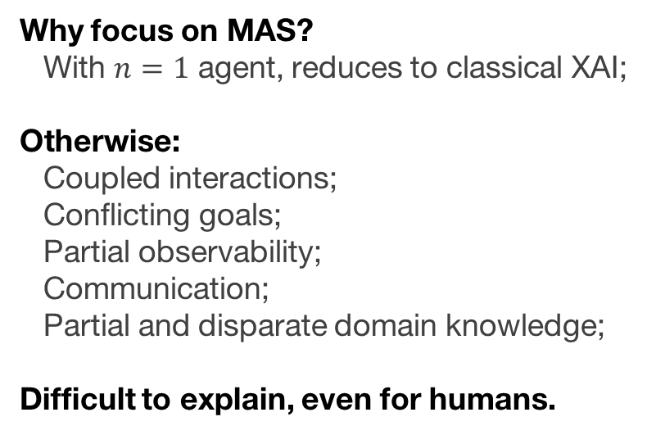
CHALLENGES OF MAS
Why focus on MAS?
With $n=1$ agent, reduces to classical XAI;
Otherwise:
Coupled interactions;
Conflicting goals;
Partial observability;
Communication;
Partial and disparate domain knowledge;
Difficult to explain, even for humans.

Slide 45
AUTONOMOUS DRIVING – DOMAIN OF APPLICATION
Example domain:
Autonomous driving (AD);
Critical environment:
Socially: Driving actions are seen and judged by others;
Epistemically: Partial observability and shared rules;
Safety: Driving can be dangerous.

Slide 46
AGENDA
What are the fundamental problems with current explainable AI (XAI)?
  Motivation for XAI is misplaced;
  Standard methods are unreliable;
  XAI evaluation is unrevealing;
How to operationalise better explanations for AI-based decision-making?
  Multi-agent systems (MAS);
  People explain all the time; study how they do it in context;

Slide 47


CLASSICAL XAI – NARY A THEORY
Classical XAI
Epistemic and functional capabilities
Epistemic and functional requirements
Explains to
User
XAI
No (or very little) overlap between what XAI offers and what the user wants.

Slide 48

HUMAN-CENTRIC XAI – WITHOUT USER REQUIREMENTS
Towards human-centric XAI
Theory
Philosophy
Cognitive science
Informs design
Interacts with
User
Social sciences
XAI
HCI
Theories about how humans explain help bring capabilities and requirements closer;
But the contexts of the domain and user are left unaddressed.

Slide 49
HUMAN-CENTRIC XAI – WITH USER REQUIREMENTS
Human-centric XAI
Theory
Philosophy
Cognitive science
Informs design
Interacts with
User
Social sciences
XAI
HCI
Elicit requirements
Elicit user requirements and expectations;
Allows us to confirm theory and tailor XAI to user requirements.

Slide 50
HOW TO ELICIT REQUIREMENTS?
But how can we ask users what sort of explanations they want?
Shouldn’t ask them to rate existing explanations:
Introduces bias;
Restricts possible space of explanations;
Potentially, a lot of ratings needed;
1. Ask them to write explanations themselves:
Still possible to instruct them;
Can interpret answers in theoretical framework;
Gives more variety;
2. Then evaluate these explanations.

Slide 51
HUMAN EXPLANATIONS FOR AUTONOMOUS DRIVING DECISIONS (HEADD)
HEADD
Human Explanations for Autonomous Driving Decisions
[18] Gyevnar, B., Droop, S., & Quillien, T. (2024, March 11). People Attribute Purpose to Autonomous Vehicles When Explaining Their Behavior. (arXiv:2402.10086). arXiv. https://doi.org/10.48550/arXiv.2403.08828

Slide 52
HEADD – ARISTOTLEAN FRAMEWORK
According to Aristotle, causal explanations have two¹ main modes;
Teleological:
Focus on the purpose the actions are meant to achieve
Mechanistic:
Focus on the mechanism that gave rise to the action.
¹Technically, Aristotle defines 4 explanatory modes, but only the above two are relevant to explaining behaviour in MAS.
[18] Gyevnar, B., Droop, S., & Quillien, T. (2024, March 11). People Attribute Purpose to Autonomous Vehicles When Explaining Their Behavior. (arXiv:2402.10086). arXiv. https://doi.org/10.48550/arXiv.2403.08828

Slide 53
WHY CAUSAL EXPLANATIONS?
Theory tells us that explanations should be:
Causal;
Contrastive;
Selected;
Conversational;
Both teleological and mechanistic explanations are causal.
[19] Miller, T. (2019). Explanation in artificial intelligence: Insights from the social sciences. Artificial Intelligence, 267, 1–38. https://doi.org/10.1016/j.artint.2018.07.007

Slide 54
HEADD
14 unique scenarios with different driving behaviour;
1,300+ human-written explanations;
4 explanatory modes
(descriptive, teleological, mechanistic, counterfactual);
4,000+ evaluations.
[18] Gyevnar, B., Droop, S., & Quillien, T. (2024, March 11). People Attribute Purpose to Autonomous Vehicles When Explaining Their Behavior. (arXiv:2402.10086). arXiv. https://doi.org/10.48550/arXiv.2403.08828

Slide 55
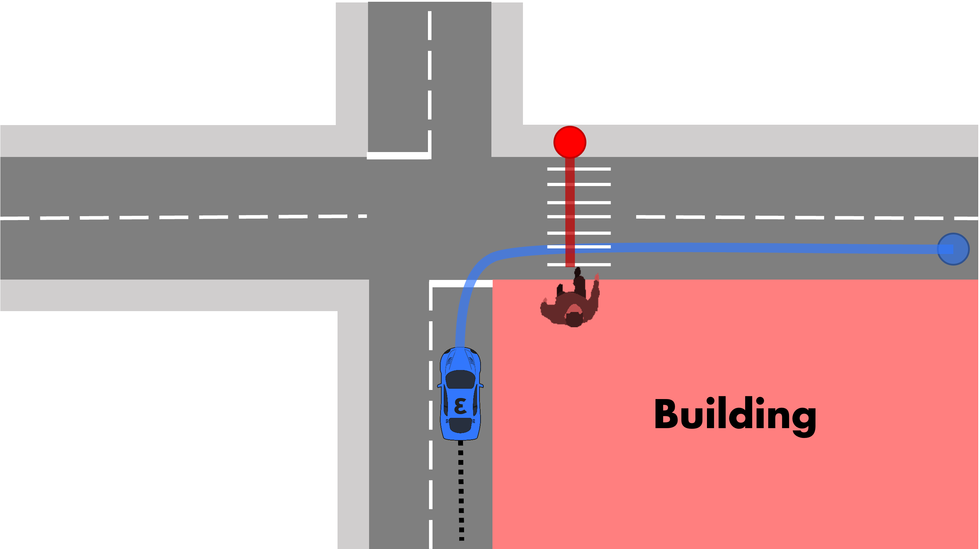
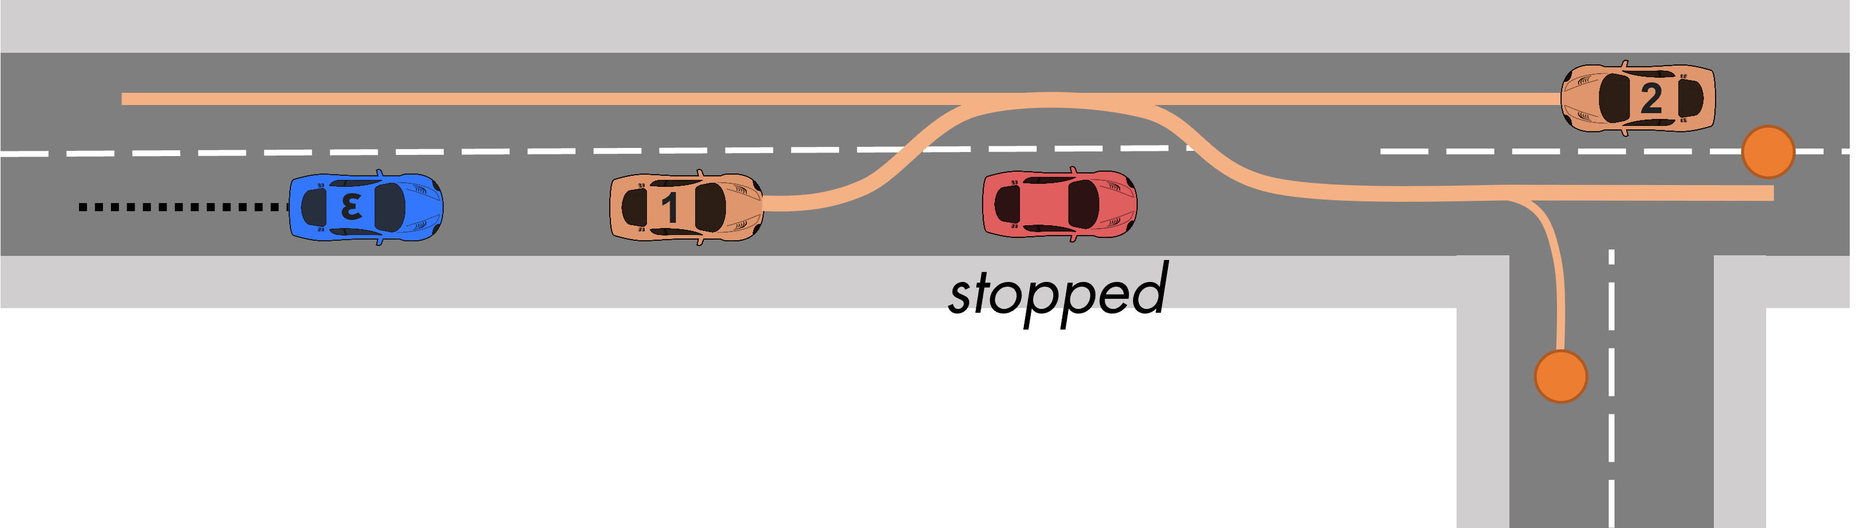
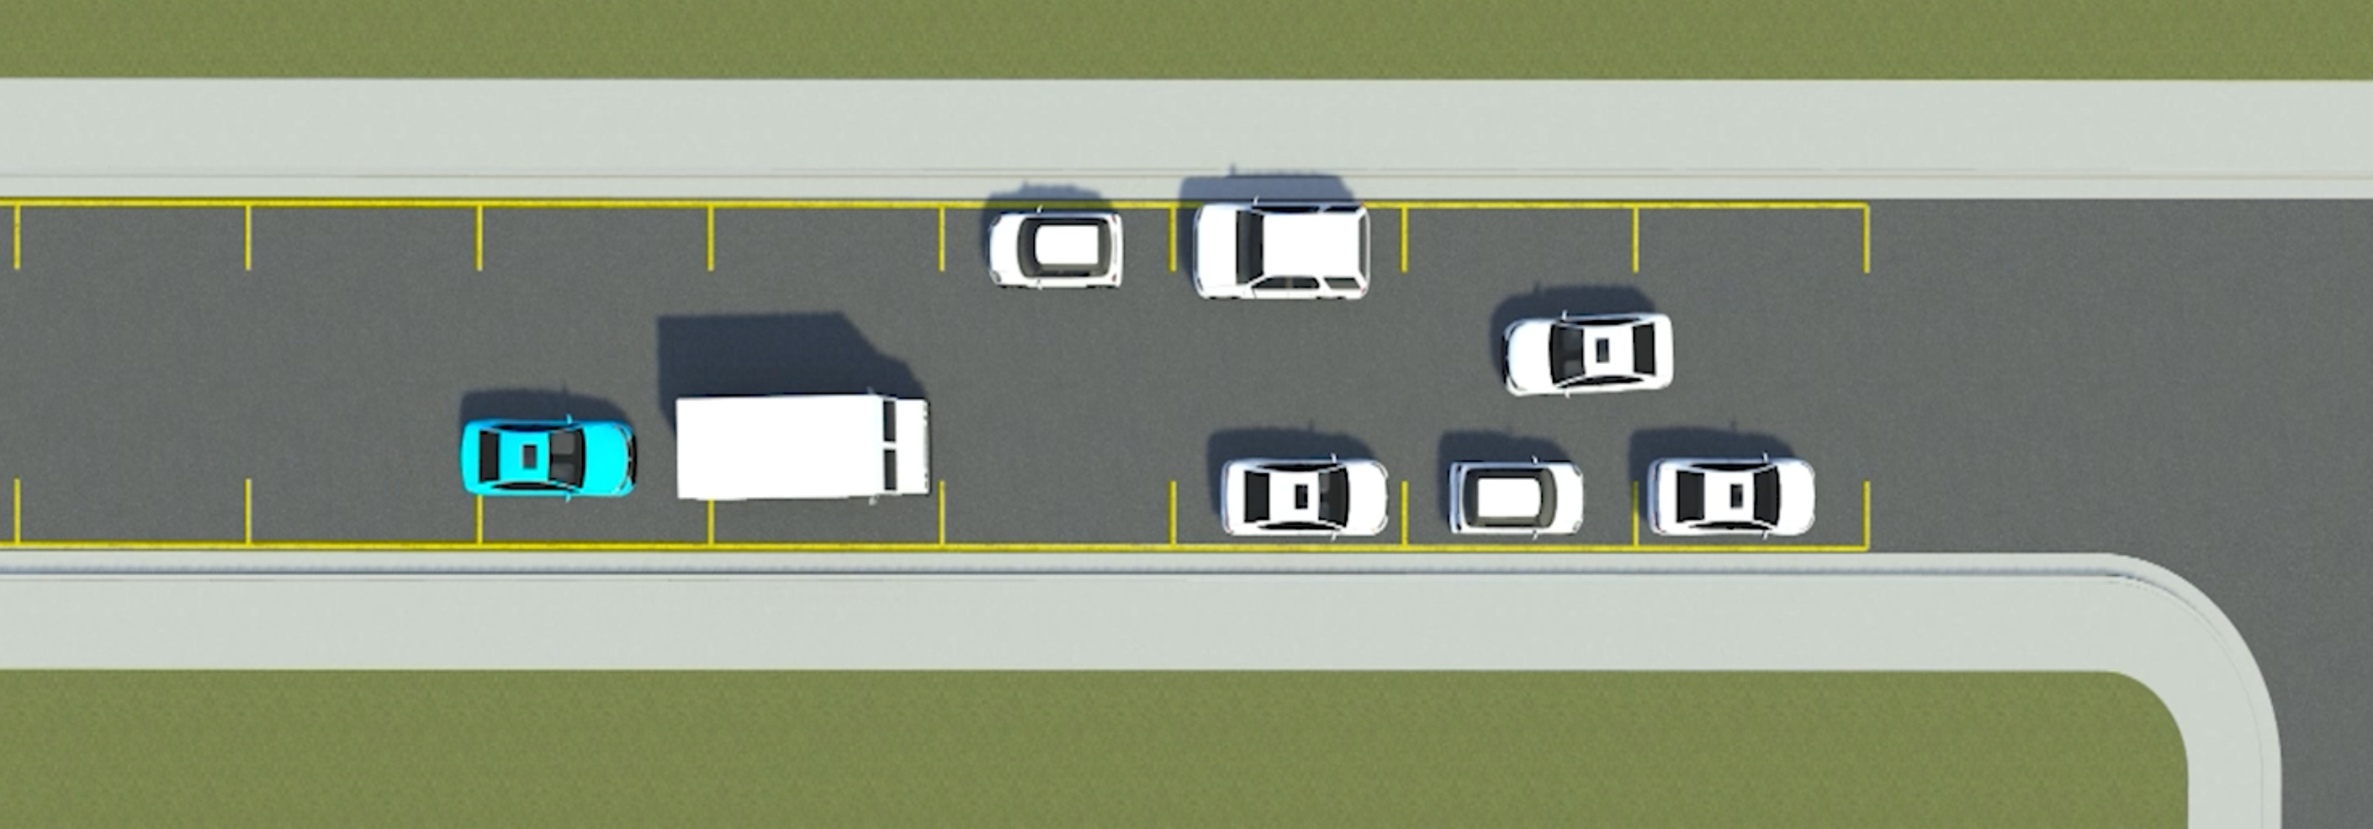
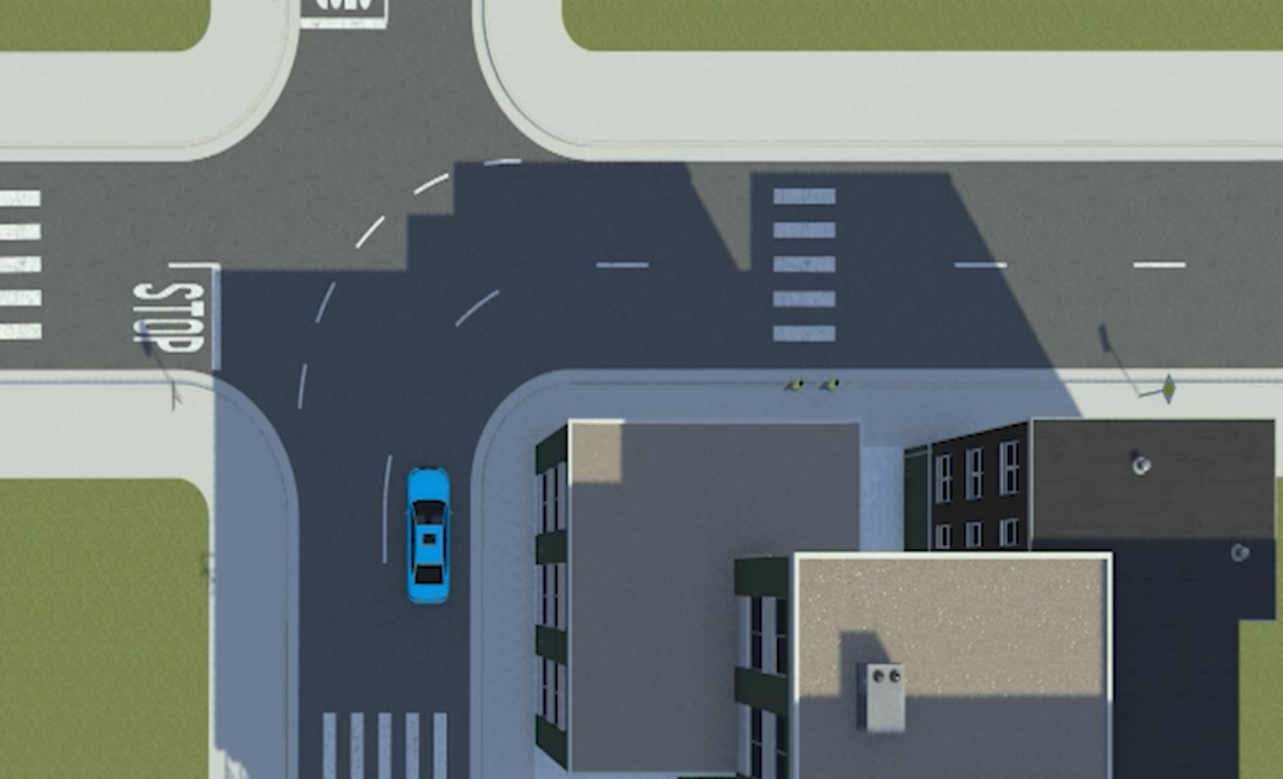
HEADD – EXAMPLE SCENARIOS
Scenario 12
Scenario 8
[18] Gyevnar, B., Droop, S., & Quillien, T. (2024, March 11). People Attribute Purpose to Autonomous Vehicles When Explaining Their Behavior. (arXiv:2402.10086). arXiv. https://doi.org/10.48550/arXiv.2403.08828

Slide 56
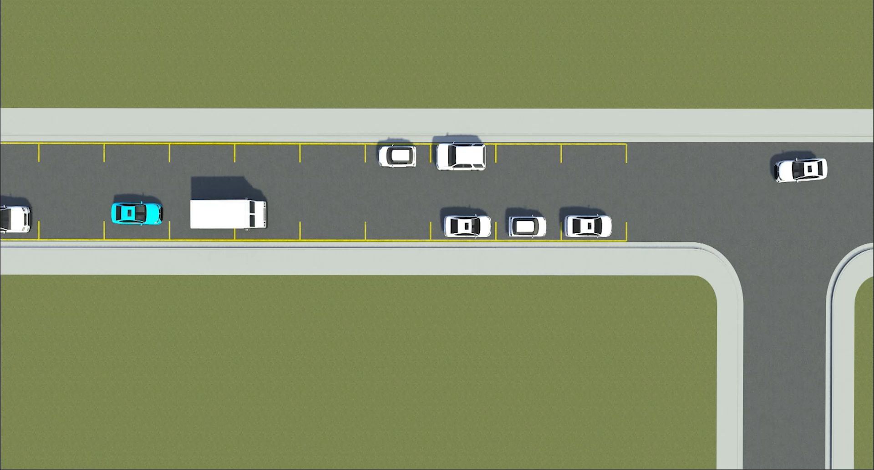
HEADD – EXAMPLE SCENARIOS
[18] Gyevnar, B., Droop, S., & Quillien, T. (2024, March 11). People Attribute Purpose to Autonomous Vehicles When Explaining Their Behavior. (arXiv:2402.10086). arXiv. https://doi.org/10.48550/arXiv.2403.08828

Slide 57
HEADD – EXAMPLE EXPLANATIONS
“The blue car was defensive. It could have overtaken the truck while the truck was waiting which could have resulted in an accident with the car approaching from the opposite side.” (counterfactual)
“The blue car was influenced by the truck ahead of it and therefore, slowed down to wait.” (mechanistic)
“Since there were cars parked on both sides of the street, neither direction had the legal right of way. They needed to cooperate with drivers in the other direction.” (teleological)
“The blue self-driving car slowed down and waiting for a parked car to come out of its space, went into the passing lane, then continued to turn into another street.” (descriptive)
[18] Gyevnar, B., Droop, S., & Quillien, T. (2024, March 11). People Attribute Purpose to Autonomous Vehicles When Explaining Their Behavior. (arXiv:2402.10086). arXiv. https://doi.org/10.48550/arXiv.2403.08828

Slide 58
HEADD - RATINGS
At least 5 annotators for each (non-descriptive) explanations:
Degree of teleology and mechanistic focus;
Perceived number of causes;
Measures of completeness, sufficiency, and trustworthiness.
[18] Gyevnar, B., Droop, S., & Quillien, T. (2024, March 11). People Attribute Purpose to Autonomous Vehicles When Explaining Their Behavior. (arXiv:2402.10086). arXiv. https://doi.org/10.48550/arXiv.2403.08828

Slide 59
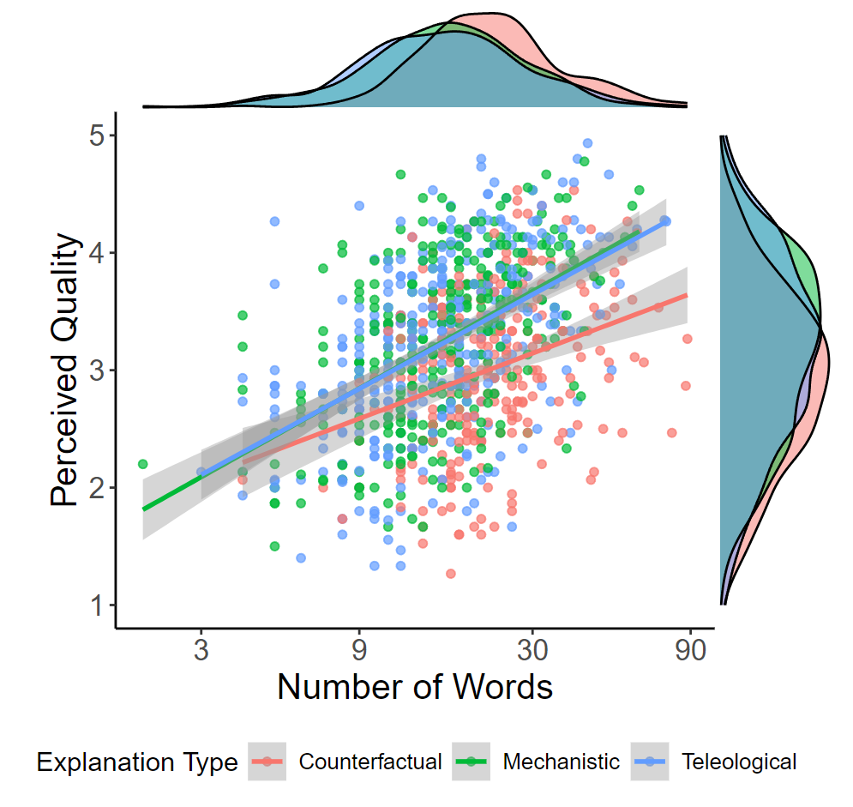
HEADD – INSIGHTS FROM THE COGNITIVE SCIENCES
[18] Gyevnar, B., Droop, S., & Quillien, T. (2024, March 11). People Attribute Purpose to Autonomous Vehicles When Explaining Their Behavior. (arXiv:2402.10086). arXiv. https://doi.org/10.48550/arXiv.2403.08828

Slide 60
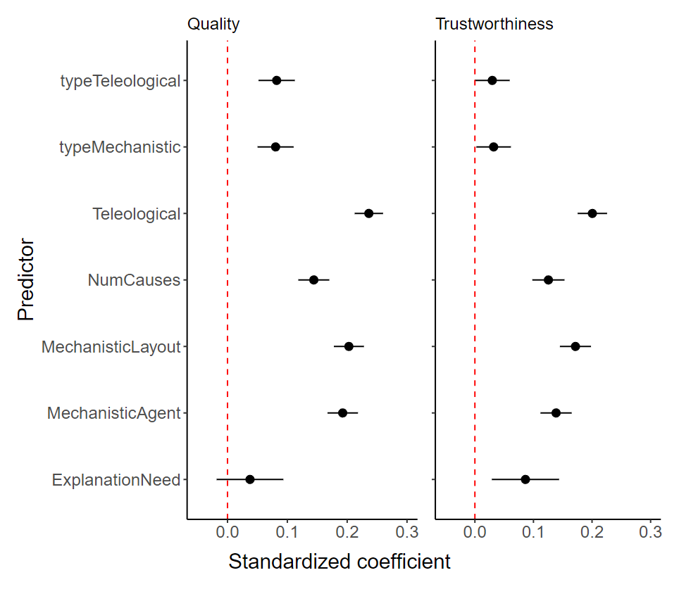
HEADD – INSIGHTS FROM THE COGNITIVE SCIENCES
[18] Gyevnar, B., Droop, S., & Quillien, T. (2024, March 11). People Attribute Purpose to Autonomous Vehicles When Explaining Their Behavior. (arXiv:2402.10086). arXiv. https://doi.org/10.48550/arXiv.2403.08828

Slide 61
HEADD – TELEOLOGY IS BEST PREDICTOR OF QUALITY
Teleological explanations best predict quality and trustworthiness;
Most of XAI focuses on mechanistic explanations;
It is important to consider explanations in terms of the goals and purpose of agents.

Slide 62
HEADD – HUMAN OR AGENT? DOESN’T MATTER
Why did the blue car change lanes?
Why did the blue autonomous vehicle choose the change lane action?
[18] Gyevnar, B., Droop, S., & Quillien, T. (2024, March 11). People Attribute Purpose to Autonomous Vehicles When Explaining Their Behavior. (arXiv:2402.10086). arXiv. https://doi.org/10.48550/arXiv.2403.08828

Slide 63
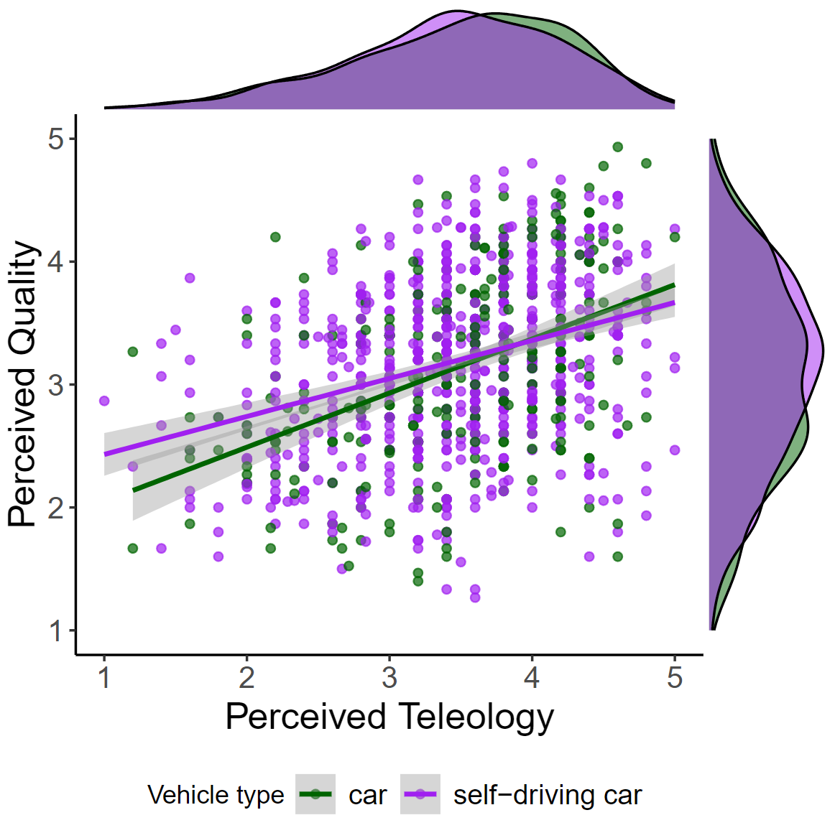
HEADD – HUMAN OR AGENT? DOESN’T MATTER
[18] Gyevnar, B., Droop, S., & Quillien, T. (2024, March 11). People Attribute Purpose to Autonomous Vehicles When Explaining Their Behavior. (arXiv:2402.10086). arXiv. https://doi.org/10.48550/arXiv.2403.08828

Slide 64
HEADD – HUMAN OR AGENT? DOESN’T MATTER
Doesn’t matter whether human or agent;
People ascribe teleological concepts to explanations anyway.
[18] Gyevnar, B., Droop, S., & Quillien, T. (2024, March 11). People Attribute Purpose to Autonomous Vehicles When Explaining Their Behavior. (arXiv:2402.10086). arXiv. https://doi.org/10.48550/arXiv.2403.08828

Slide 65
AGENDA
What are the fundamental problems with current explainable AI (XAI)?
  Motivation for XAI is misplaced;
  Standard methods are unreliable;
  XAI evaluation is unrevealing;
How to operationalise better explanations for AI-based decision-making?
  Multi-agent systems (MAS);
  People explain all the time; study how they do it;
  Causal Explanations for Sequential Decision-Making in MAS.

Slide 66
WHY CAUSAL EXPLANATIONS?
Human-centric XAI
Theory
Philosophy
Cognitive science
Informs design
Interacts with
User
XAI
Social sciences
Elicit requirements

Slide 67
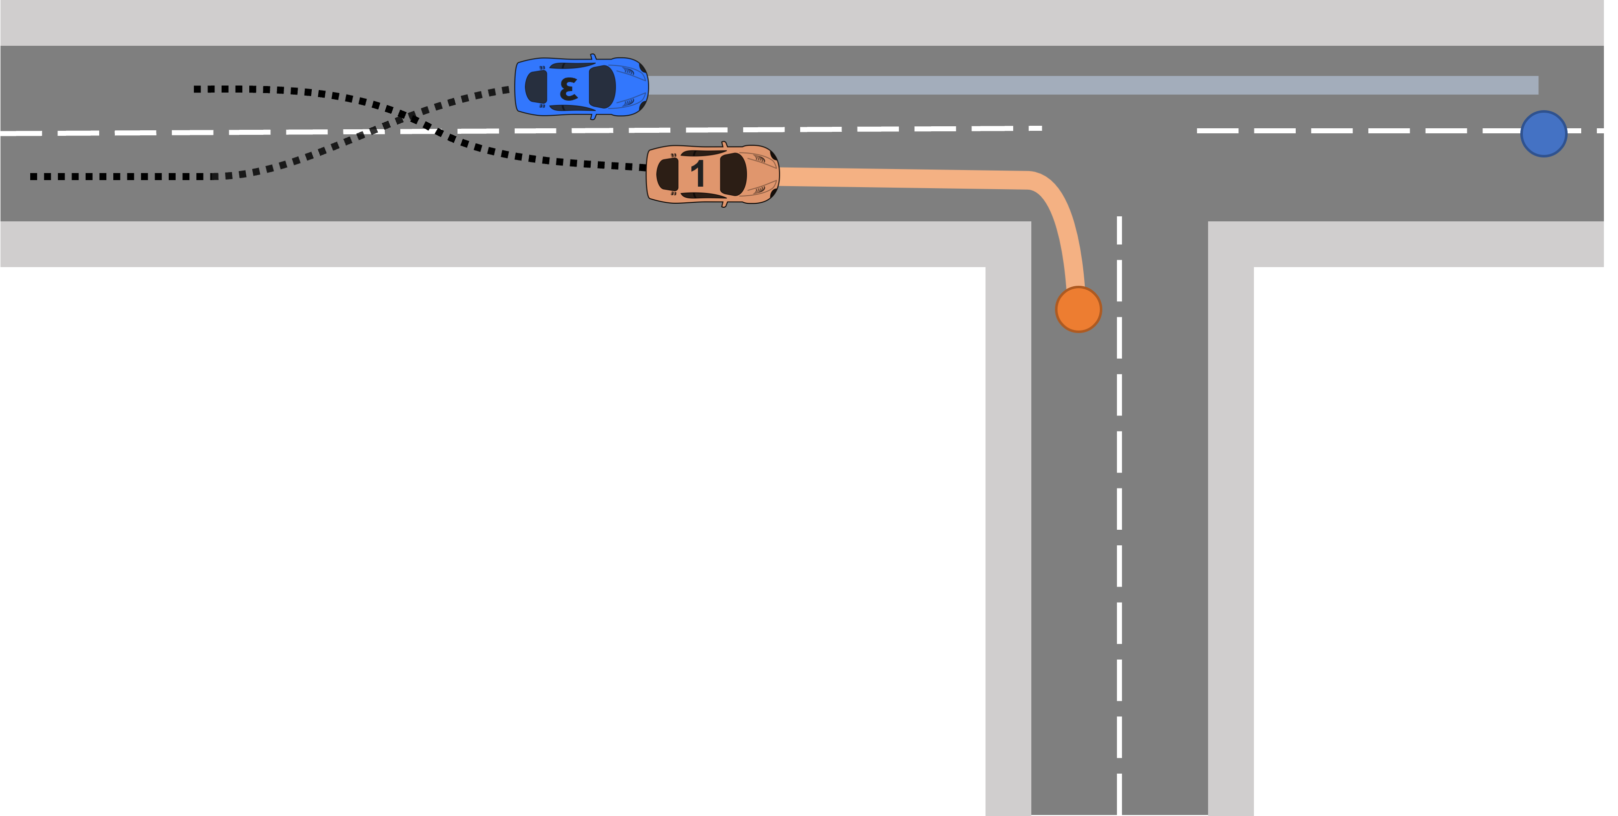
ILLUSTRATIVE SCENARIO
[20] Albrecht, S. V., Brewitt, C., Wilhelm, J., Gyevnar, B., Eiras, F., Dobre, M., & Ramamoorthy, S. (2021, March 15). Interpretable Goal-based Prediction and Planning for Autonomous Driving. IEEE International Conference on Robotics and Automation (ICRA). https://ieeexplore.ieee.org/document/9560849

Slide 68
EXAMPLE INTERACTION
User
Agent
Why did you change lanes?
It decreases the time to reach the goal.
Teleological
Why does it decrease the time to the goal?
Because vehicle 1 was slower than us.
Why was it slower?
It was decelerating and turning right.
Mechanistic
What if it hadn’t changed lanes before?
We would have gone straight.
[4] Gyevnar, B., Wang, C., Lucas, C. G., Cohen, S. B., & Albrecht, S. V. (2024, May). Causal Explanations for Sequential Decision-Making in Multi-Agent Systems. 23rd International Conference on Autonomous Agents and Multi-Agent Systems (AAMAS). https://doi.org/10.48550/arXiv.2302.10809

Slide 69
CAUSAL EXPLANATIONS FOR MULTI-AGENT SYSTEMS (CEMA)
CEMA
Causal Explanations for Multi-Agent Systems
[4] Gyevnar, B., Wang, C., Lucas, C. G., Cohen, S. B., & Albrecht, S. V. (2024, May). Causal Explanations for Sequential Decision-Making in Multi-Agent Systems. 23rd International Conference on Autonomous Agents and Multi-Agent Systems (AAMAS). https://doi.org/10.48550/arXiv.2302.10809

Slide 70
WHY USE CEMA?
Applicable whenever you have:
Probabilistic model to predict future actions of others;
No explicit assumptions on causal structure;
Provides:
Contrastive, causal, and selected explanations;
Designed for interaction.
[4] Gyevnar, B., Wang, C., Lucas, C. G., Cohen, S. B., & Albrecht, S. V. (2024, May). Causal Explanations for Sequential Decision-Making in Multi-Agent Systems. 23rd International Conference on Autonomous Agents and Multi-Agent Systems (AAMAS). https://doi.org/10.48550/arXiv.2302.10809

Slide 71
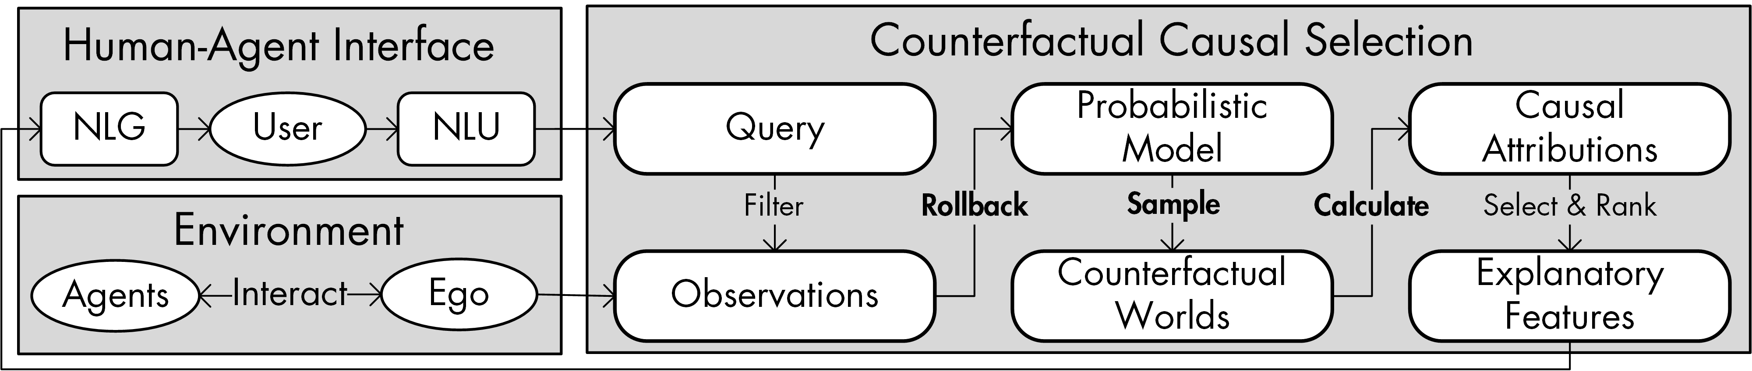
STRUCTURE OF CEMA
[4] Gyevnar, B., Wang, C., Lucas, C. G., Cohen, S. B., & Albrecht, S. V. (2024, May). Causal Explanations for Sequential Decision-Making in Multi-Agent Systems. 23rd International Conference on Autonomous Agents and Multi-Agent Systems (AAMAS). https://doi.org/10.48550/arXiv.2302.10809

Slide 72
THREE-STEP APPROACH
Rollback → Sample → Correlate
Counterfactual Effect Size Model (CESM)
[4] Gyevnar, B., Wang, C., Lucas, C. G., Cohen, S. B., & Albrecht, S. V. (2024, May). Causal Explanations for Sequential Decision-Making in Multi-Agent Systems. 23rd International Conference on Autonomous Agents and Multi-Agent Systems (AAMAS). https://doi.org/10.48550/arXiv.2302.10809

Slide 73
COUNTERFACTUAL EFFECT SIZE MODEL (CESM)
Based on how people might select causes to explain;
People simulate counterfactuals to select causes:
  Using some prior (cognitive) distribution;
  But anchored to observations;
People use correlation to select among causes:
  C caused E if C is highly correlated with E across counterfactuals.
[1] Quillien, T., & Lucas, C. G. (2023, June 8). Counterfactuals and the Logic of Causal Selection. Psychological Review. Advance online publication. https://dx.doi.org/10.1037/rev0000428
[4] Gyevnar, B., Wang, C., Lucas, C. G., Cohen, S. B., & Albrecht, S. V. (2024, May). Causal Explanations for Sequential Decision-Making in Multi-Agent Systems. 23rd International Conference on Autonomous Agents and Multi-Agent Systems (AAMAS). https://doi.org/10.48550/arXiv.2302.10809

Slide 74
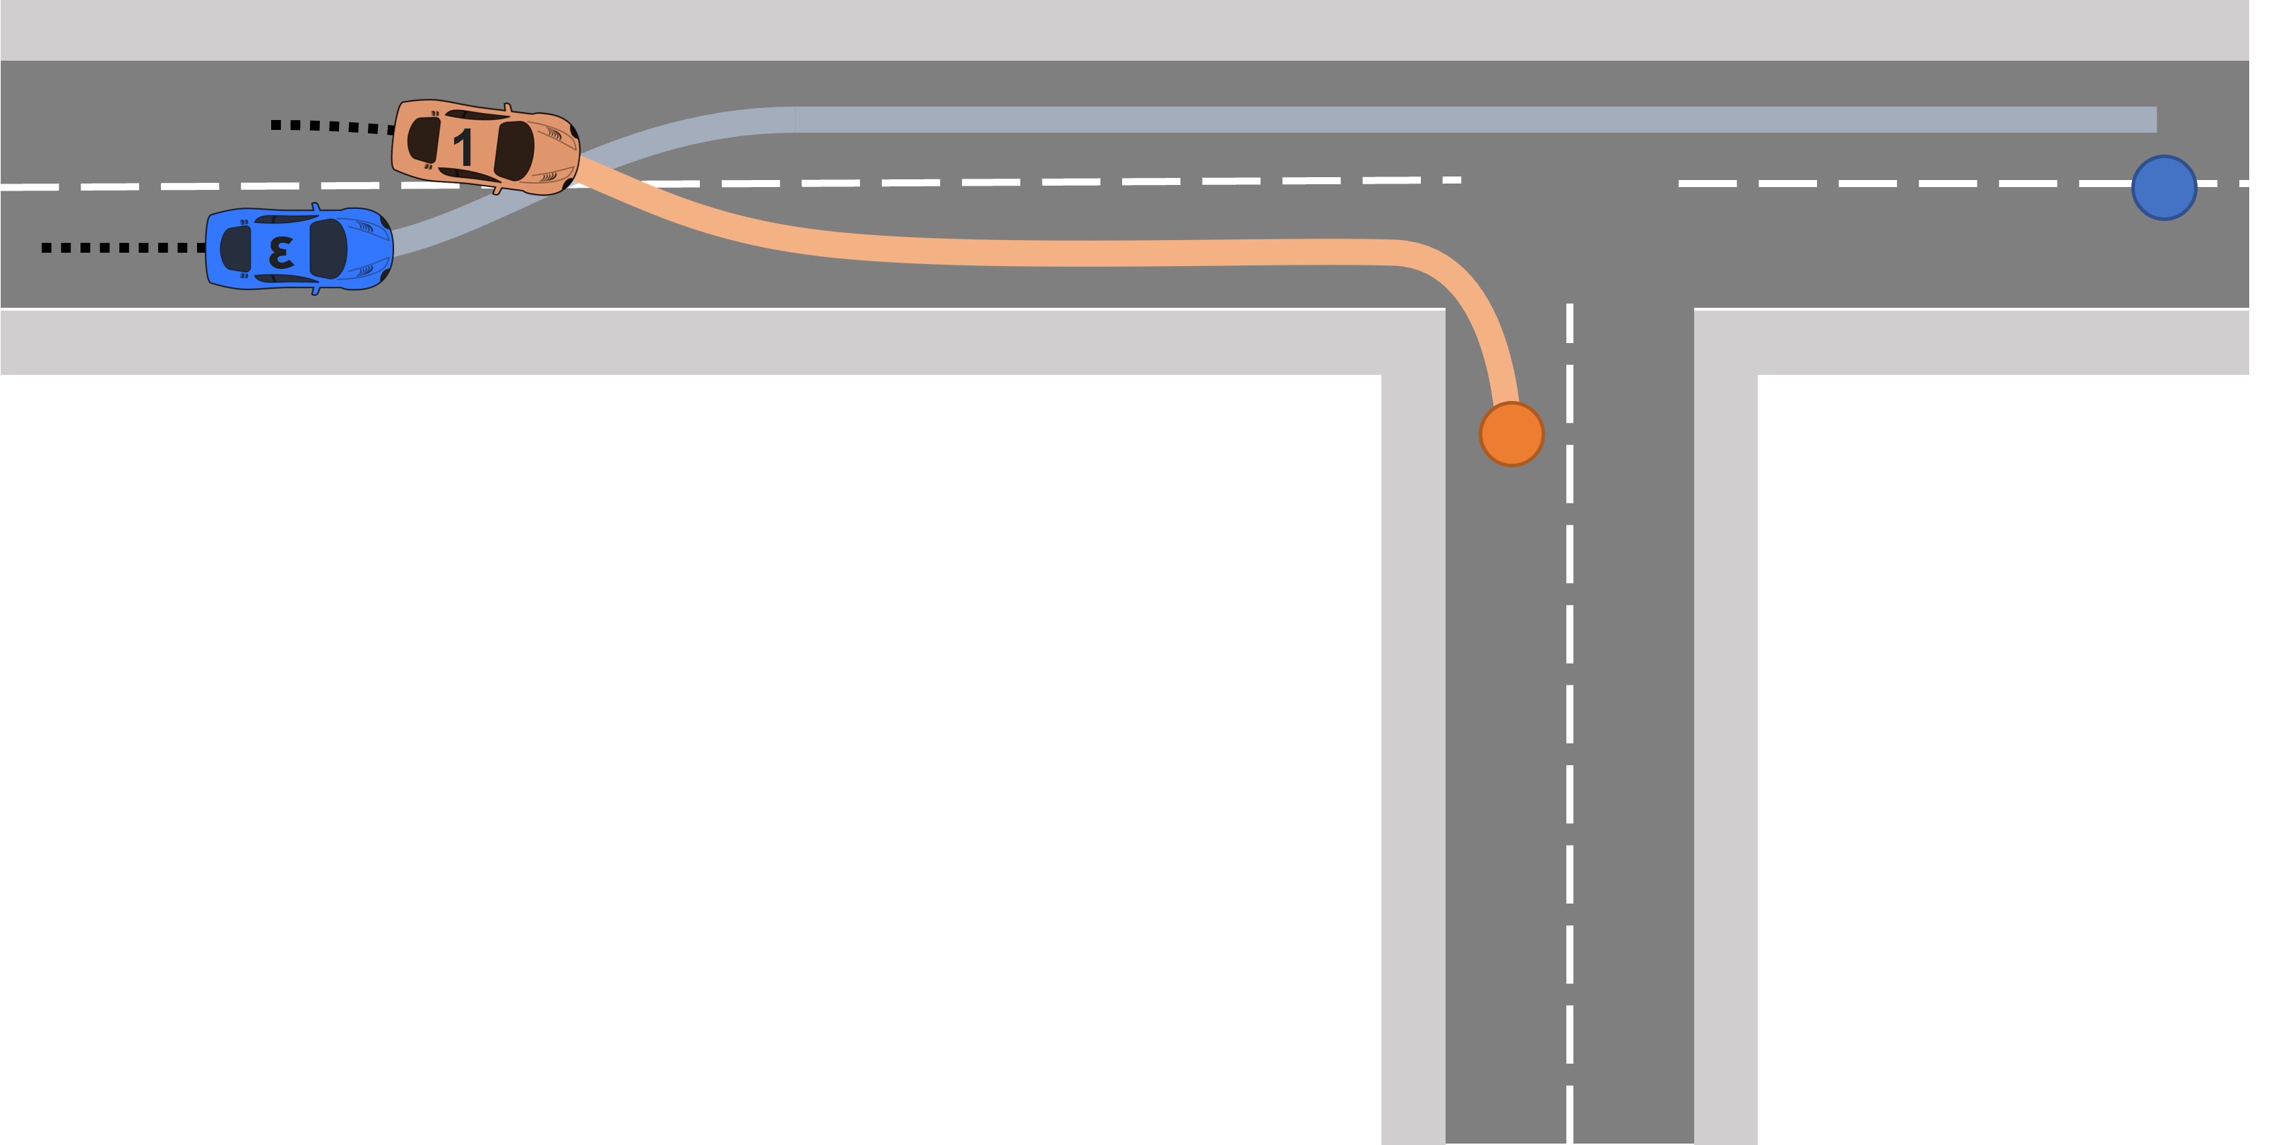

ROLLBACK
Observed trajectory:${ s}_{1:t}$
Rollback → Sample → Calculate
[4] Gyevnar, B., Wang, C., Lucas, C. G., Cohen, S. B., & Albrecht, S. V. (2024, May). Causal Explanations for Sequential Decision-Making in Multi-Agent Systems. 23rd International Conference on Autonomous Agents and Multi-Agent Systems (AAMAS). https://doi.org/10.48550/arXiv.2302.10809

Slide 75

ROLLBACK
Rolled back trajectory: $s_{1:τ}$
Rollback → Sample → Calculate
[4] Gyevnar, B., Wang, C., Lucas, C. G., Cohen, S. B., & Albrecht, S. V. (2024, May). Causal Explanations for Sequential Decision-Making in Multi-Agent Systems. 23rd International Conference on Autonomous Agents and Multi-Agent Systems (AAMAS). https://doi.org/10.48550/arXiv.2302.10809

Slide 76
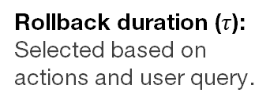
ROLLBACK
Rolled back trajectory: $s_{1:τ}$
Rollback duration ($τ$):
Selected based on actions and user query.
Rollback → Sample → Calculate
[4] Gyevnar, B., Wang, C., Lucas, C. G., Cohen, S. B., & Albrecht, S. V. (2024, May). Causal Explanations for Sequential Decision-Making in Multi-Agent Systems. 23rd International Conference on Autonomous Agents and Multi-Agent Systems (AAMAS). https://doi.org/10.48550/arXiv.2302.10809

Slide 77
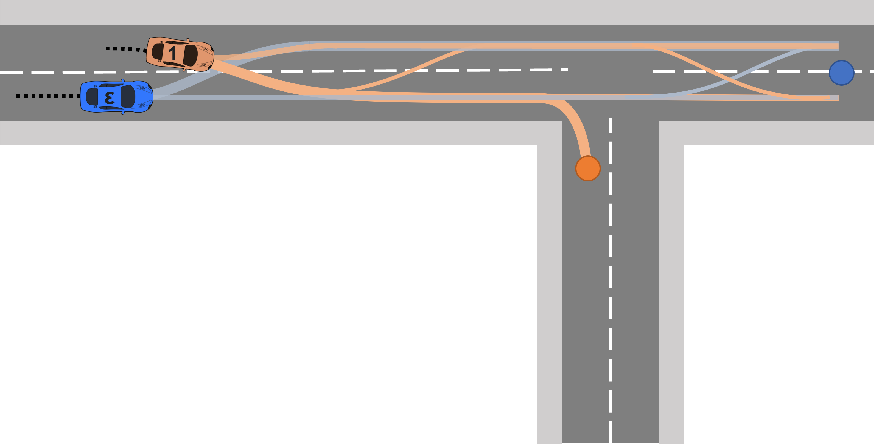
SAMPLE (COUNTER)FACTUALS
Sample (counter)factual worlds $∼{p(s}_{τ:n}|s_{1:τ})$
Rollback → Sample → Calculate
[4] Gyevnar, B., Wang, C., Lucas, C. G., Cohen, S. B., & Albrecht, S. V. (2024, May). Causal Explanations for Sequential Decision-Making in Multi-Agent Systems. 23rd International Conference on Autonomous Agents and Multi-Agent Systems (AAMAS). https://doi.org/10.48550/arXiv.2302.10809

Slide 78
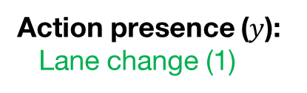
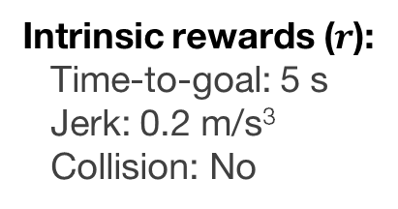
SAMPLE (COUNTER)FACTUALS
Action presence ($y$):
Lane change (1)
Intrinsic rewards ($r$):
Time-to-goal: 5 s
Jerk: 0.2 m/s³
Collision: No
Features for trajectory:
{Decelerate, Turn, Slower, etc…}
Rollback → Sample → Calculate
[4] Gyevnar, B., Wang, C., Lucas, C. G., Cohen, S. B., & Albrecht, S. V. (2024, May). Causal Explanations for Sequential Decision-Making in Multi-Agent Systems. 23rd International Conference on Autonomous Agents and Multi-Agent Systems (AAMAS). https://doi.org/10.48550/arXiv.2302.10809

Slide 79
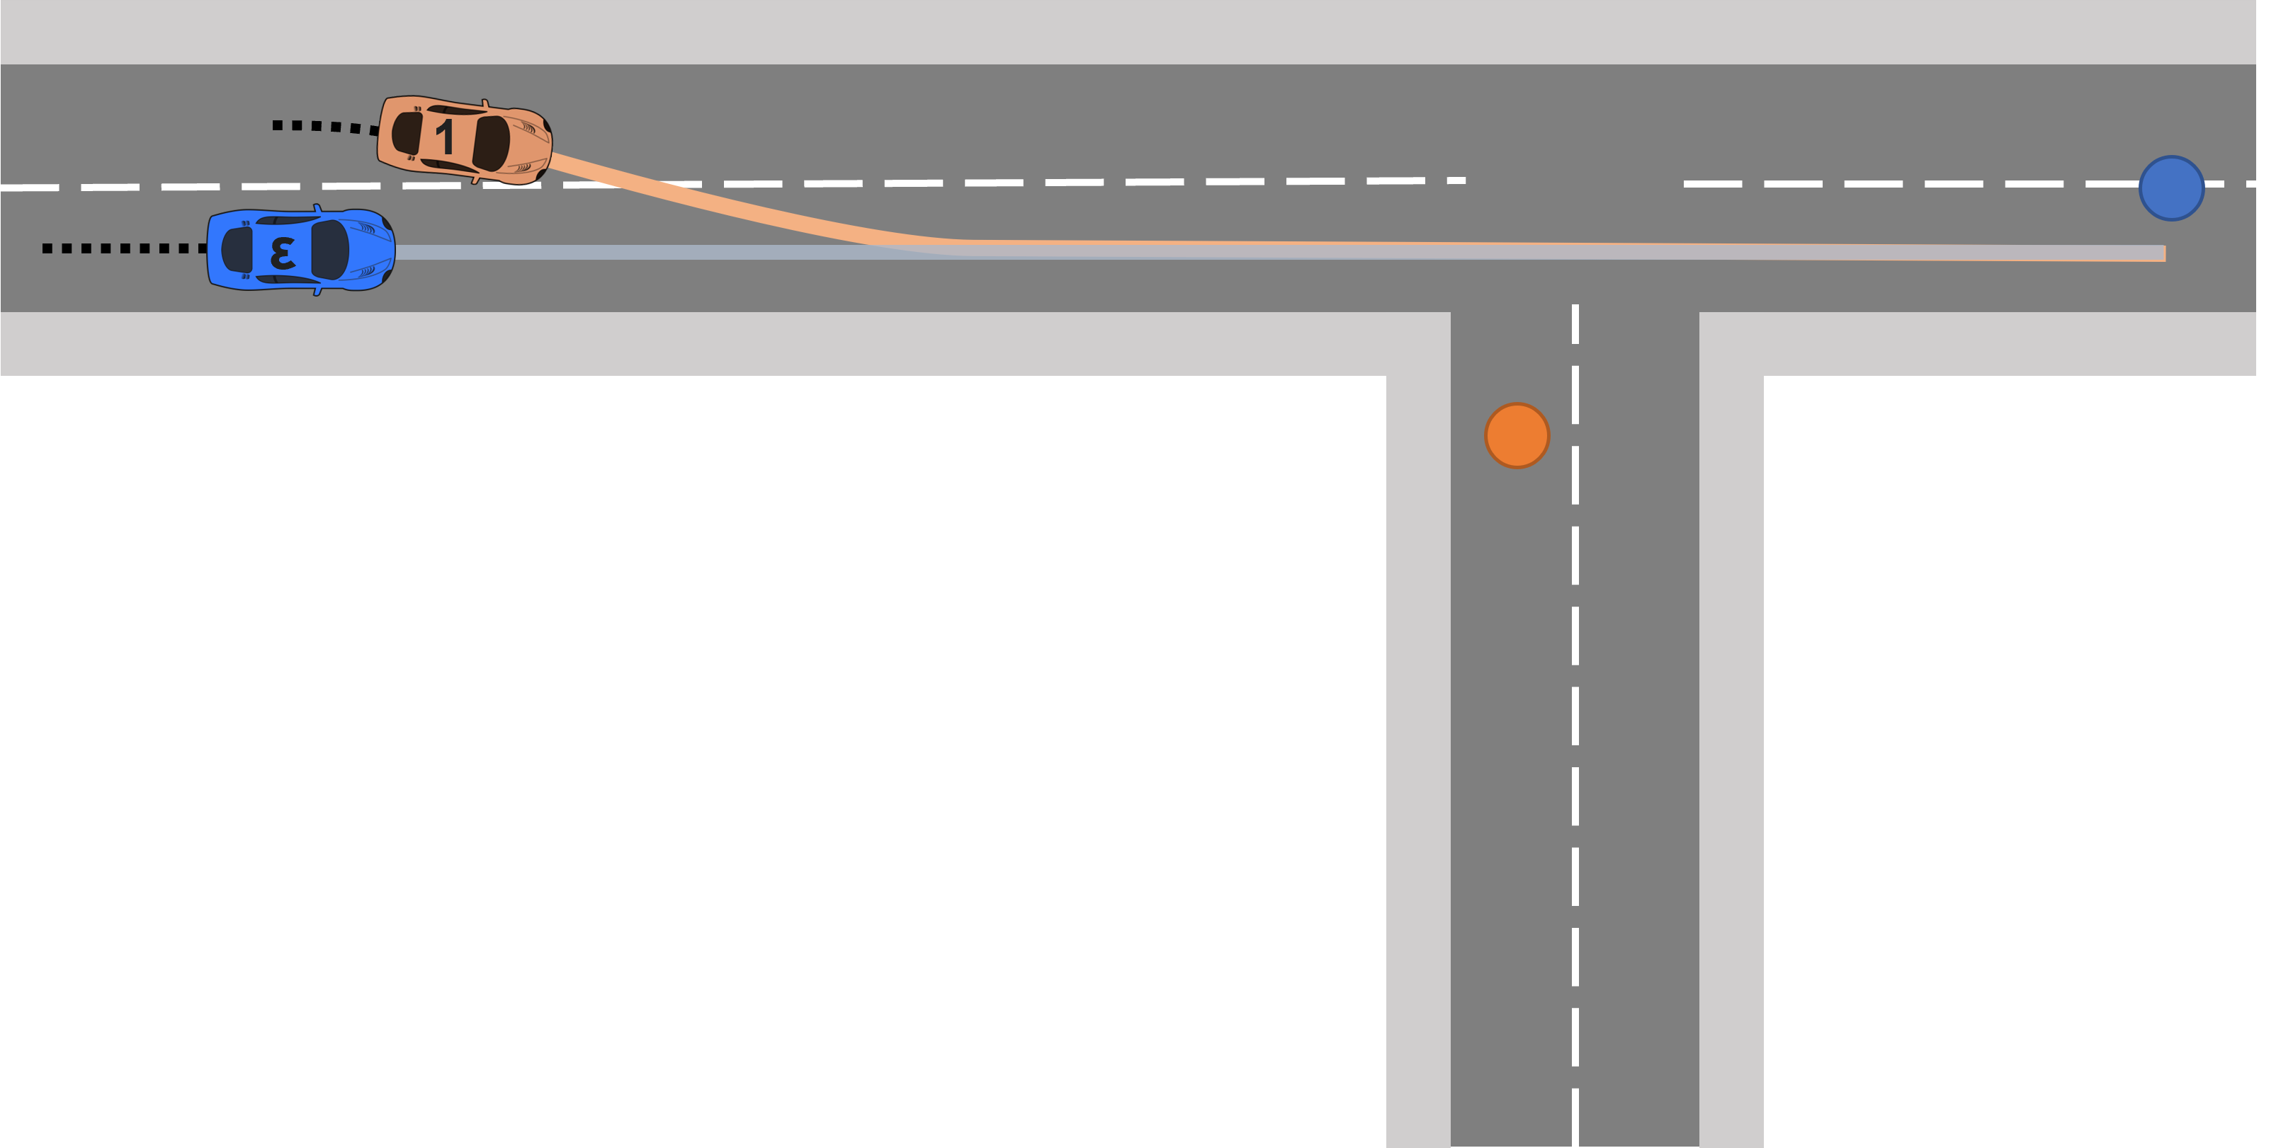
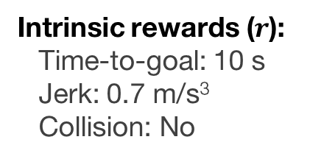
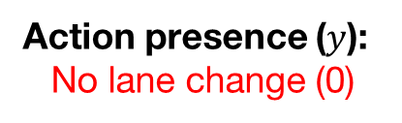
SAMPLE (COUNTER)FACTUALS
Action presence ($y$):
No lane change (0)
Intrinsic rewards ($r$):
Time-to-goal: 10 s
Jerk: 0.7 m/s³
Collision: No
Features for trajectory:
{Accelerate, Continue, Faster, etc…}
Rollback → Sample → Calculate
[4] Gyevnar, B., Wang, C., Lucas, C. G., Cohen, S. B., & Albrecht, S. V. (2024, May). Causal Explanations for Sequential Decision-Making in Multi-Agent Systems. 23rd International Conference on Autonomous Agents and Multi-Agent Systems (AAMAS). https://doi.org/10.48550/arXiv.2302.10809

Slide 80



CALCULATE – SOME NOTATION
$$r=\left[\begin{matrix}\text{t}\text{ime}\text{−}\text{to}\text{−}\text{goal} \\ ⋮ \\ \text{curvature}\end{matrix}\right]$$
$$𝒟={\left\{\left(s_{τ:n}^{k},y^{k},r^{k}\right)\right\}}_{k=1}^{K}$$
$$𝒳=\left\{r|y^{k}∈𝒟∧y_{q}=y^{k}\right\}$$
Reward component vector
Sampled set of worlds
Sampled worlds where query occurred
Rollback → Sample → Calculate
[4] Gyevnar, B., Wang, C., Lucas, C. G., Cohen, S. B., & Albrecht, S. V. (2024, May). Causal Explanations for Sequential Decision-Making in Multi-Agent Systems. 23rd International Conference on Autonomous Agents and Multi-Agent Systems (AAMAS). https://doi.org/10.48550/arXiv.2302.10809

Slide 81

CALCULATE – TELEOLOGICAL CAUSES
$$Δ=𝔼_{𝒳}\left[r\right]−𝔼_{\overline{𝒳}}\left[r\right]$$
Expected difference of rewards between:
Worlds where query happened;
Where query did not happen.
Rollback → Sample → Calculate
[4] Gyevnar, B., Wang, C., Lucas, C. G., Cohen, S. B., & Albrecht, S. V. (2024, May). Causal Explanations for Sequential Decision-Making in Multi-Agent Systems. 23rd International Conference on Autonomous Agents and Multi-Agent Systems (AAMAS). https://doi.org/10.48550/arXiv.2302.10809

Slide 82
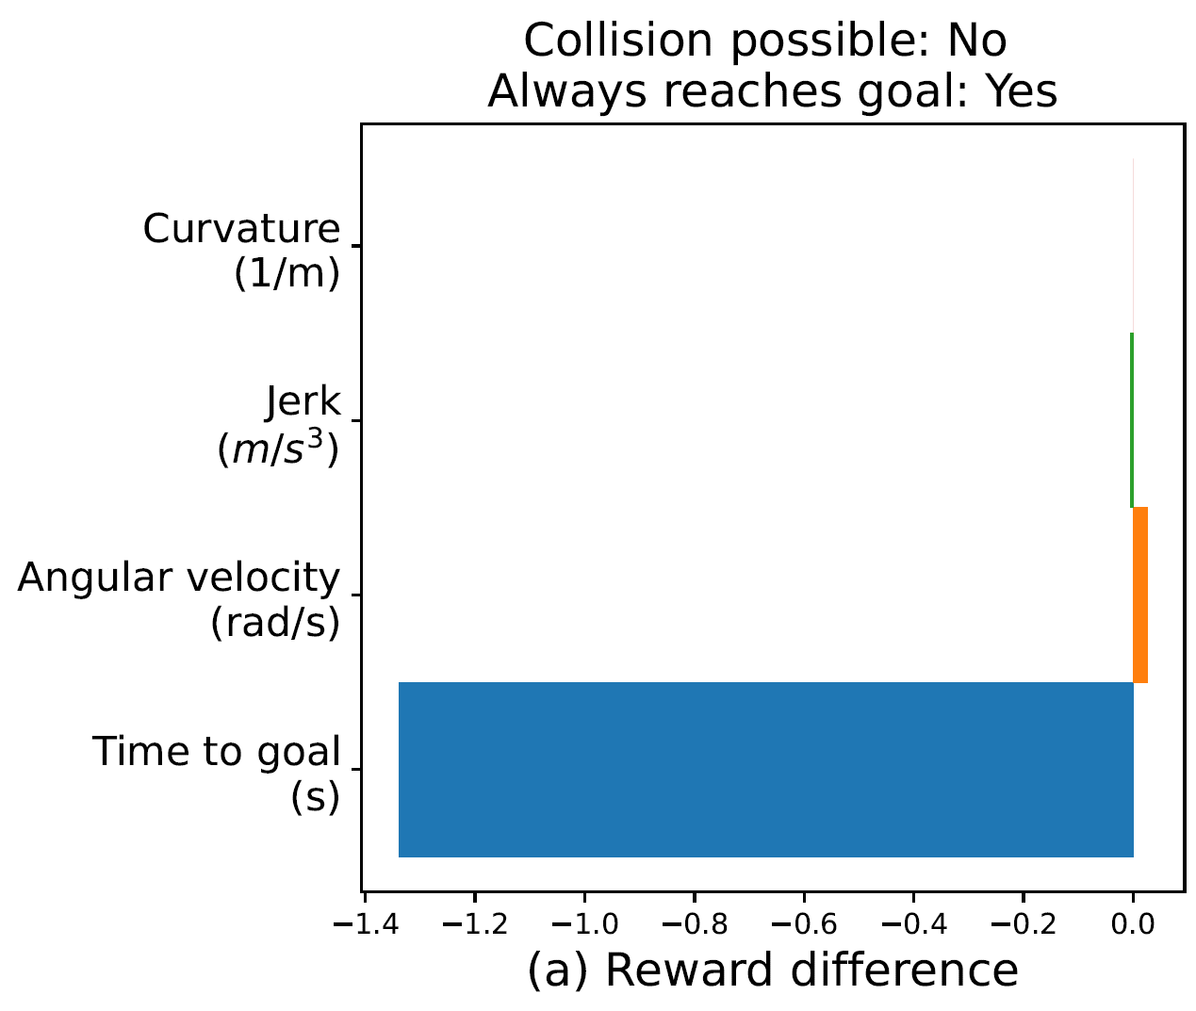
CALCULATE – TELEOLOGICAL CAUSES
Rollback → Sample → Calculate
[4] Gyevnar, B., Wang, C., Lucas, C. G., Cohen, S. B., & Albrecht, S. V. (2024, May). Causal Explanations for Sequential Decision-Making in Multi-Agent Systems. 23rd International Conference on Autonomous Agents and Multi-Agent Systems (AAMAS). https://doi.org/10.48550/arXiv.2302.10809

Slide 83
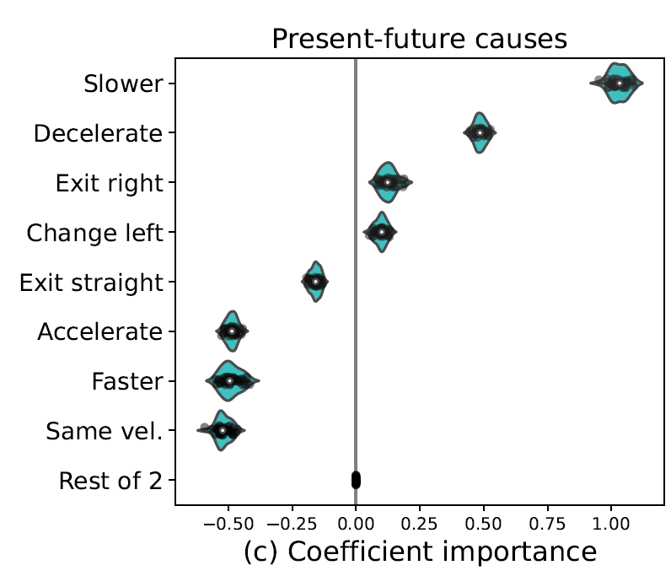
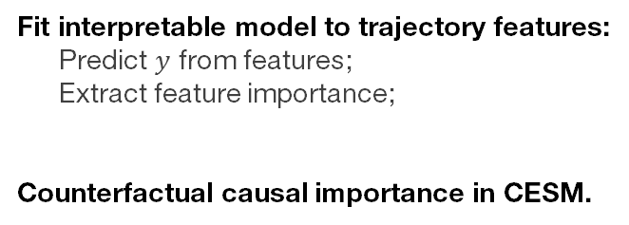
CALCULATE – MECHANISTIC CAUSES
Fit interpretable model to trajectory features:
Predict $y$ from features;
Extract feature importance;
Counterfactual causal importance in CESM.
Mechanistic
Rollback → Sample → Calculate
[4] Gyevnar, B., Wang, C., Lucas, C. G., Cohen, S. B., & Albrecht, S. V. (2024, May). Causal Explanations for Sequential Decision-Making in Multi-Agent Systems. 23rd International Conference on Autonomous Agents and Multi-Agent Systems (AAMAS). https://doi.org/10.48550/arXiv.2302.10809

Slide 84
ROBUSTNESS – MECHANISTIC CAUSES
[4] Gyevnar, B., Wang, C., Lucas, C. G., Cohen, S. B., & Albrecht, S. V. (2024, May). Causal Explanations for Sequential Decision-Making in Multi-Agent Systems. 23rd International Conference on Autonomous Agents and Multi-Agent Systems (AAMAS). https://doi.org/10.48550/arXiv.2302.10809

Slide 85
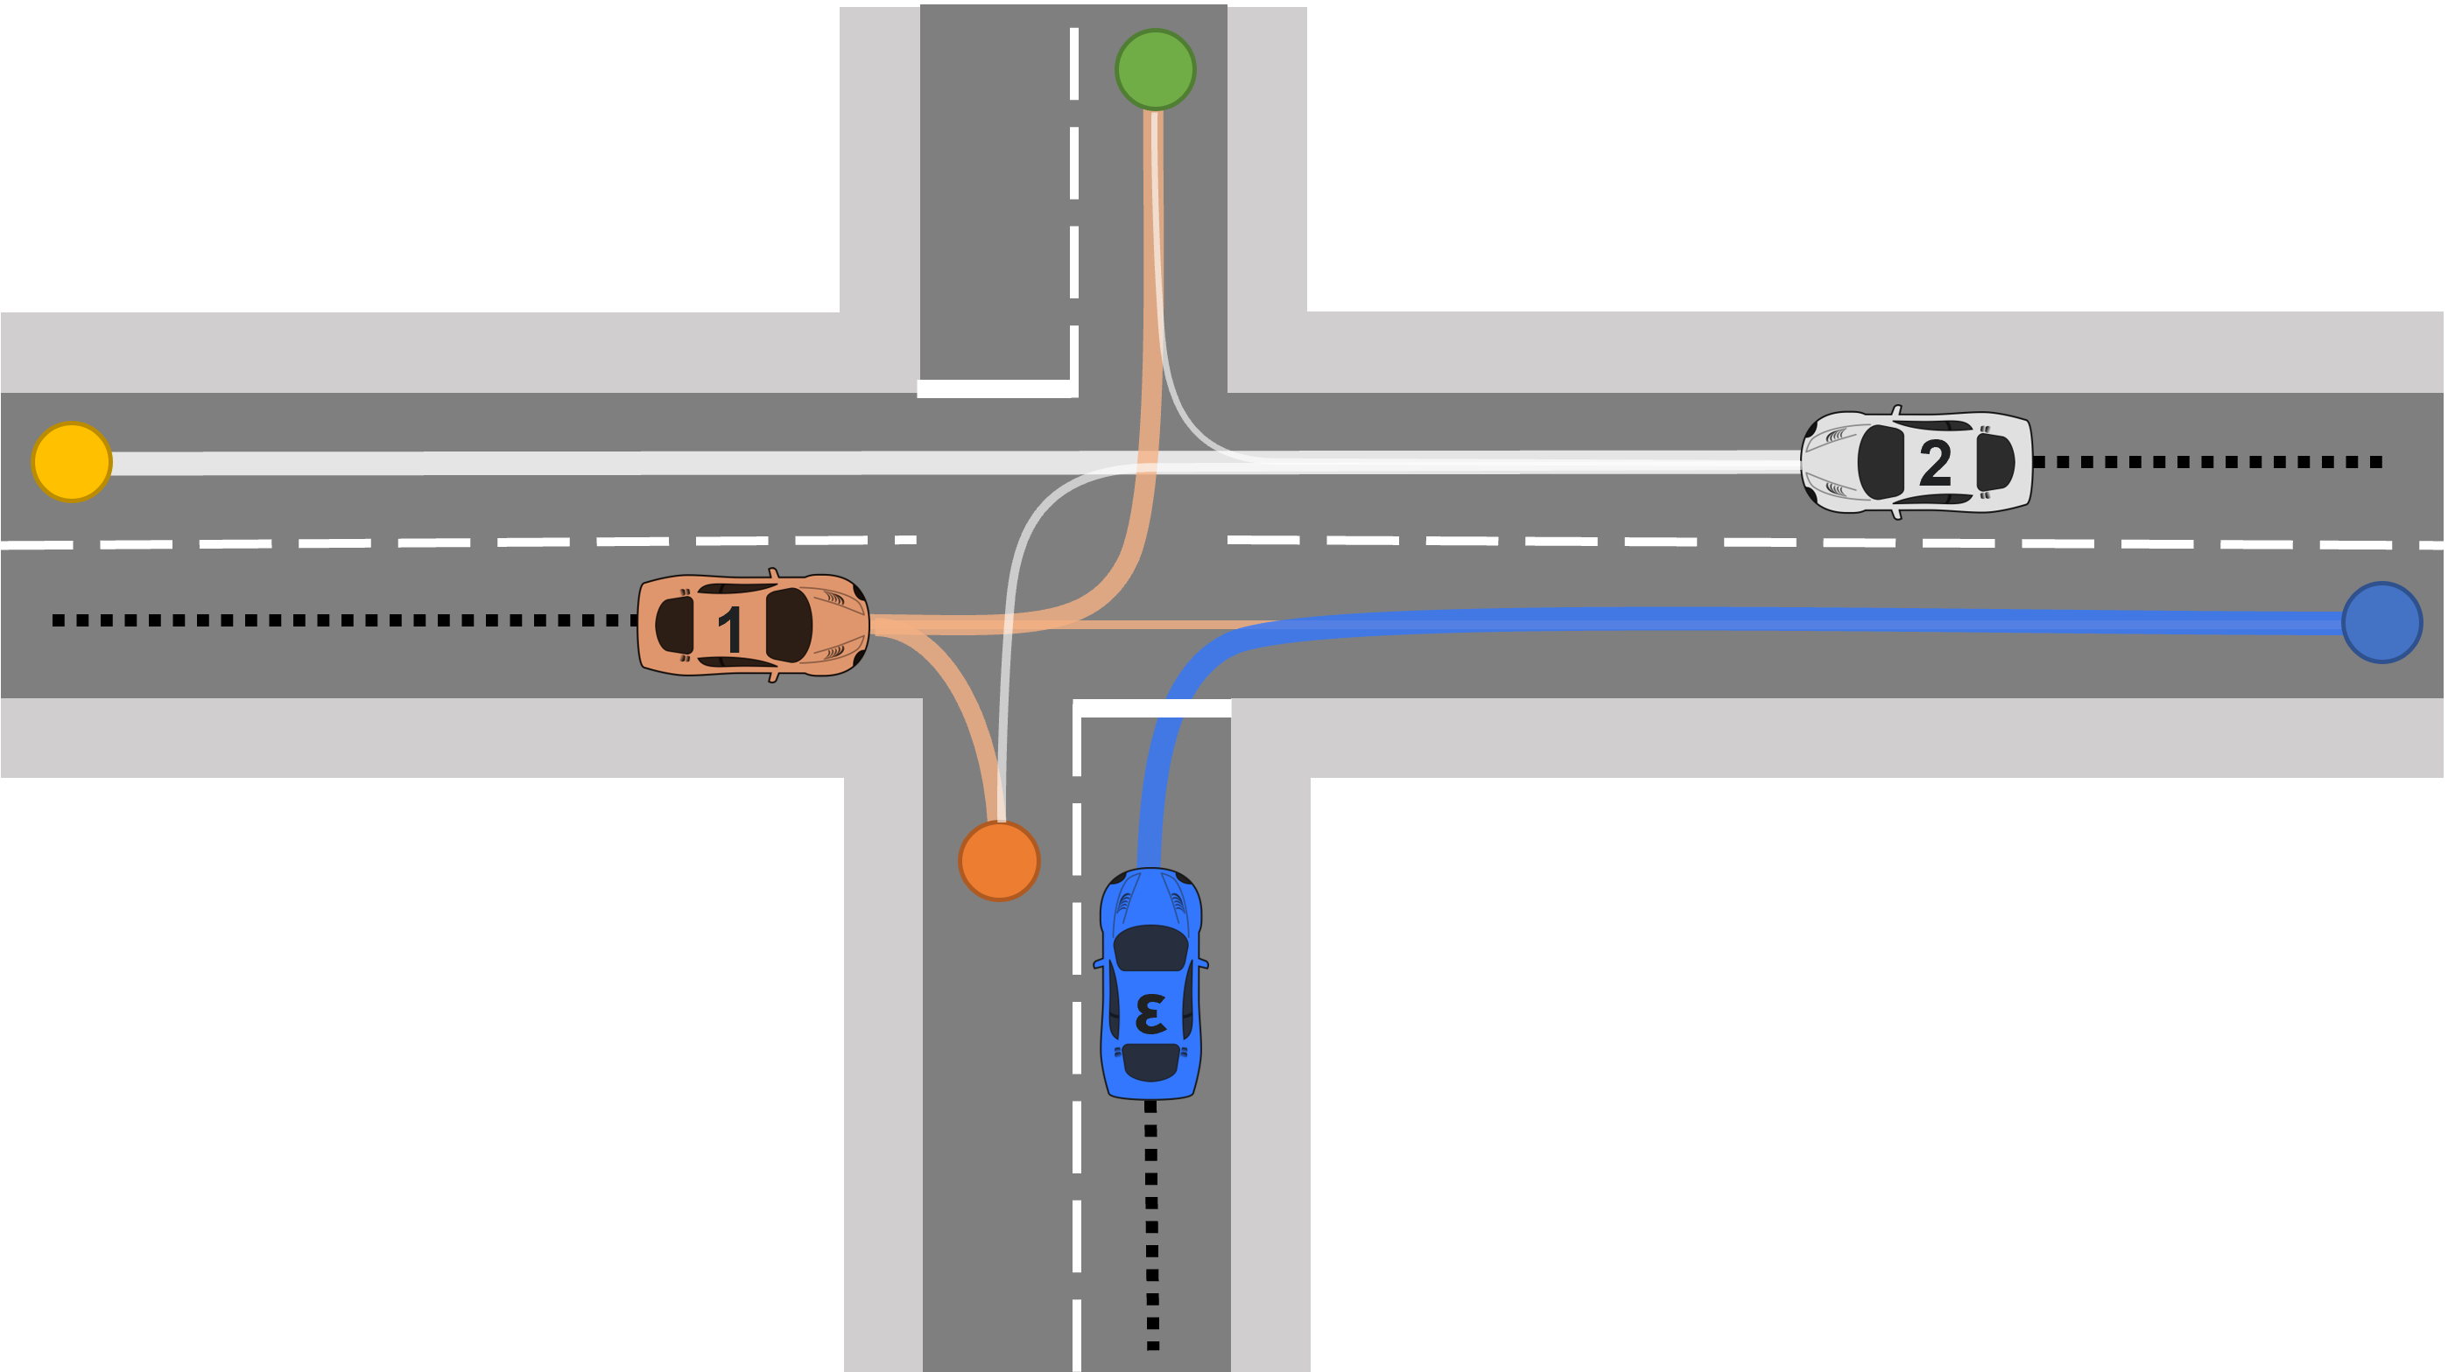
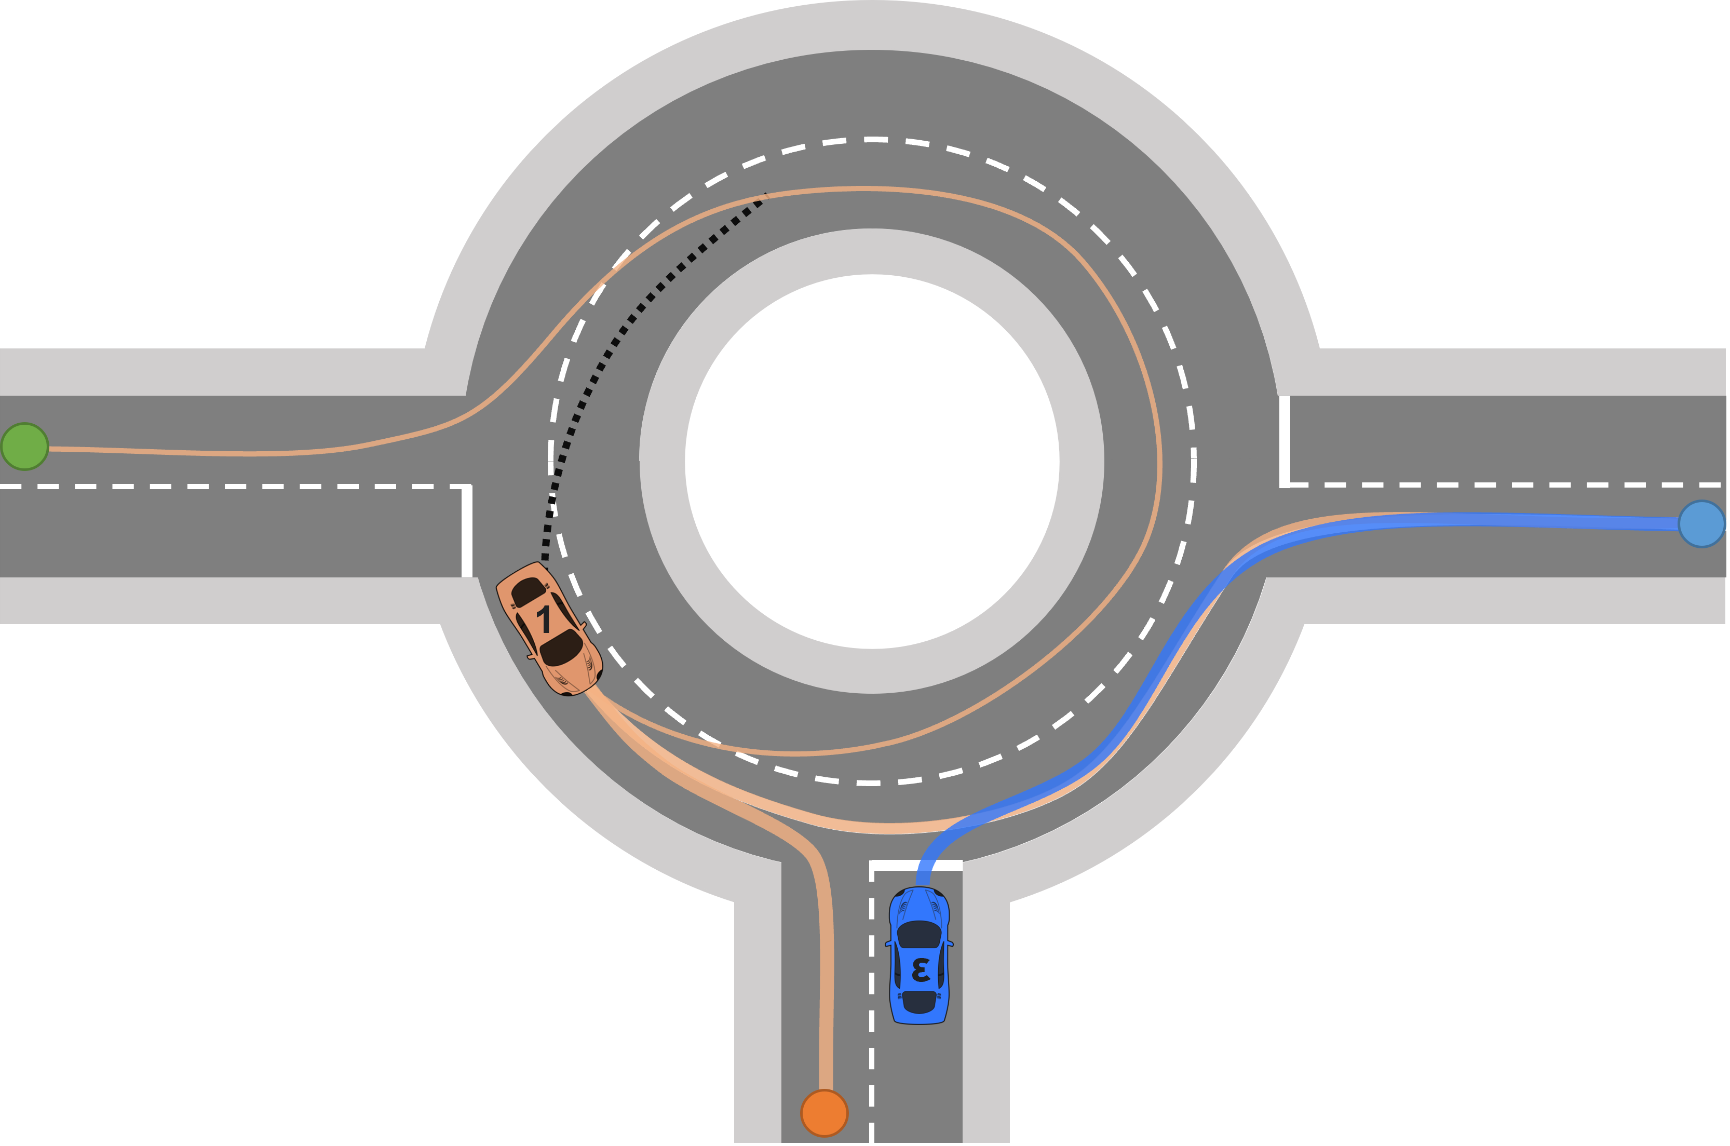
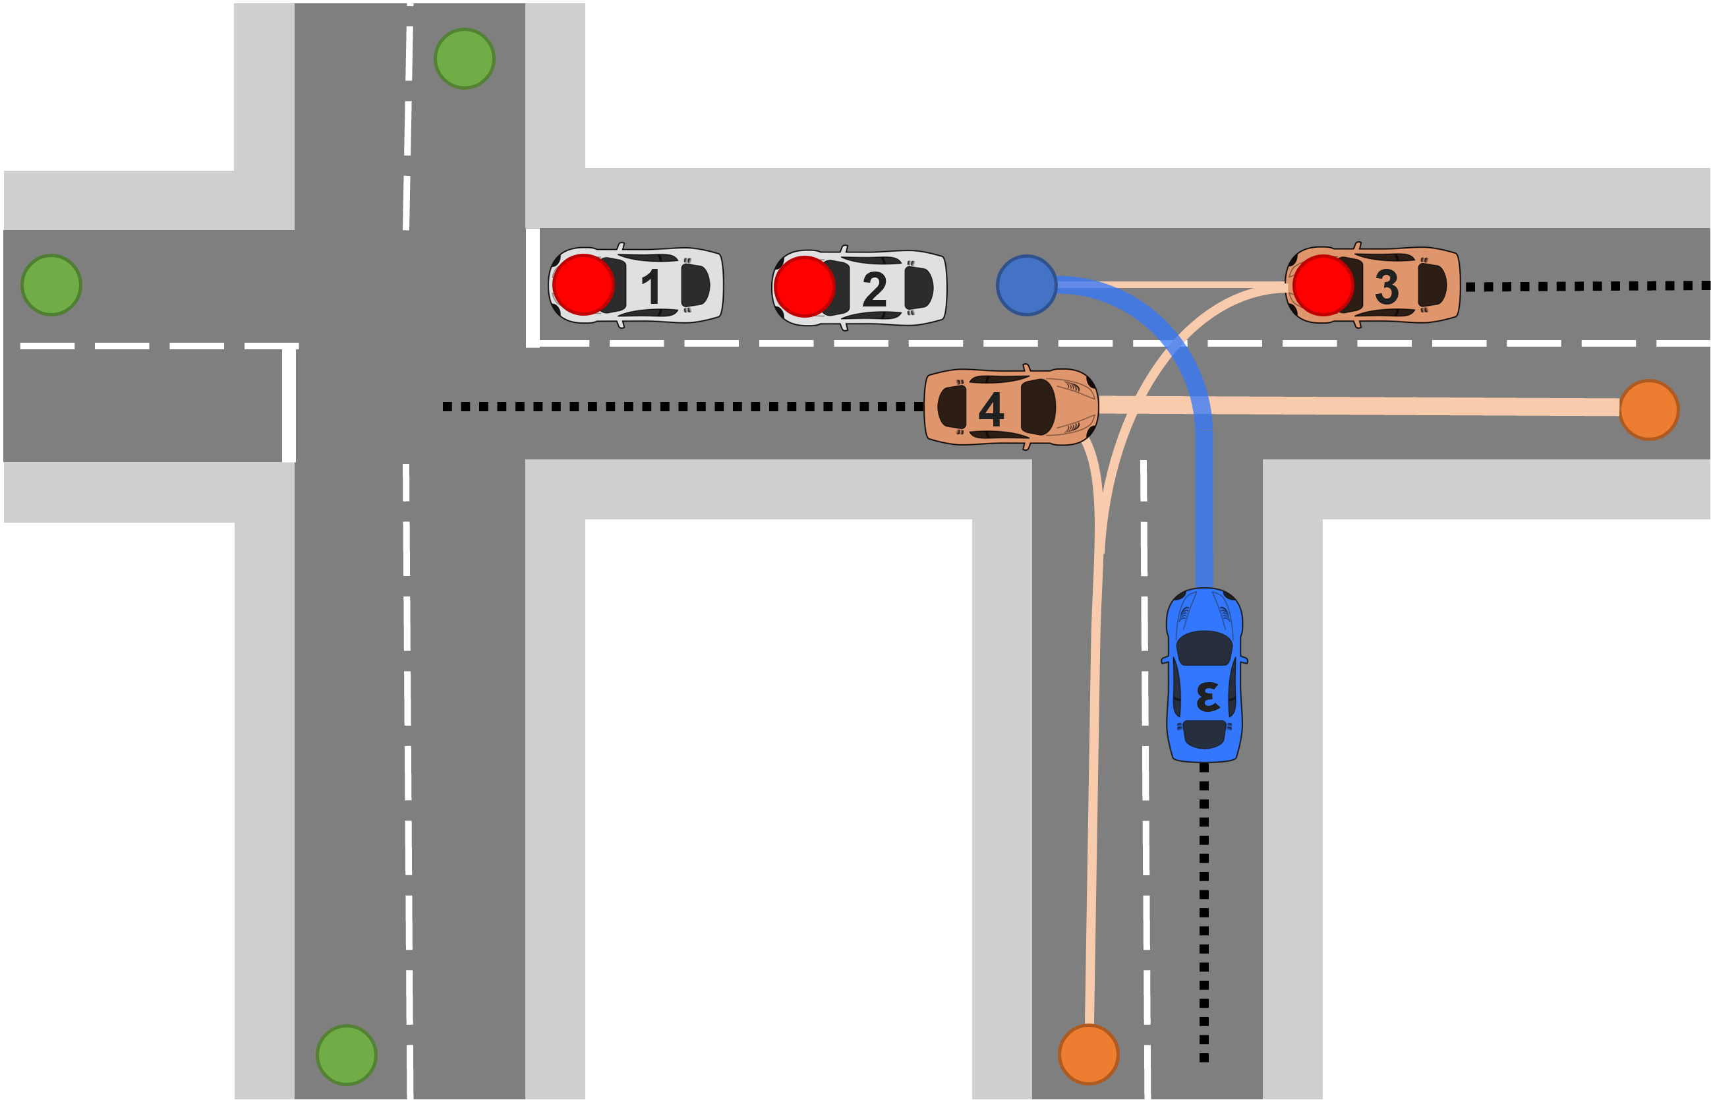
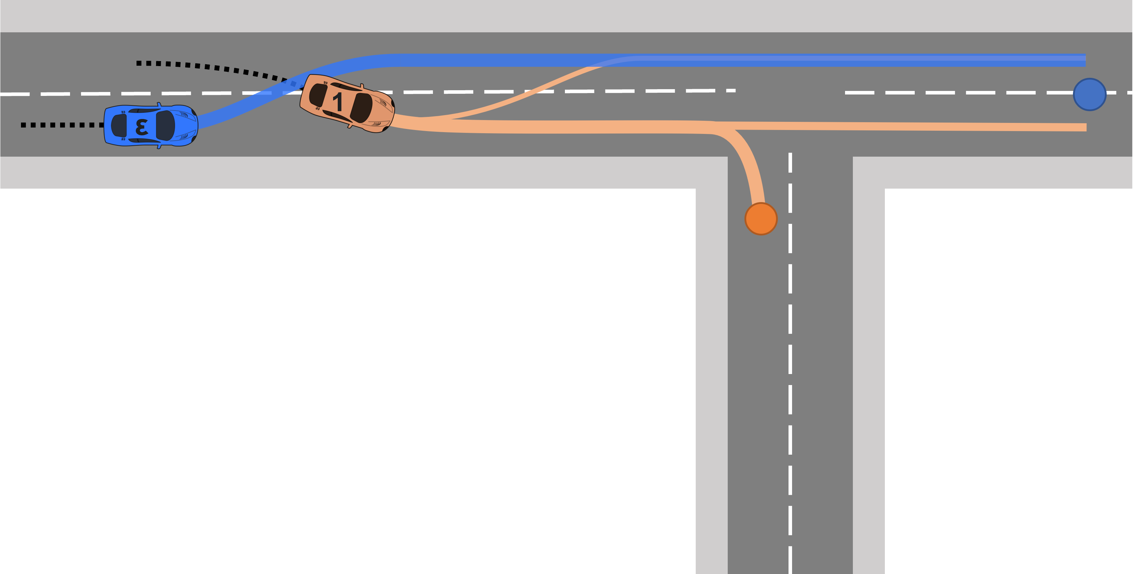
FOUR SCENARIOS
[4] Gyevnar, B., Wang, C., Lucas, C. G., Cohen, S. B., & Albrecht, S. V. (2024, May). Causal Explanations for Sequential Decision-Making in Multi-Agent Systems. 23rd International Conference on Autonomous Agents and Multi-Agent Systems (AAMAS). https://doi.org/10.48550/arXiv.2302.10809

Slide 86
NATURAL LANGUAGE GENERATION
Conversation loop:
Users poses query;
CEMA gives natural language explanation (NLE);
Benefits of NLEs:
More intelligible;
Lower cognitive overhead;
Natural language generation:
Template realisation engine;
Deterministic outputs.
It decreases the time to reach the goal.
Because vehicle 1 was slower than us.
It was decelerating and turning right.
We would have gone straight.
[4] Gyevnar, B., Wang, C., Lucas, C. G., Cohen, S. B., & Albrecht, S. V. (2024, May). Causal Explanations for Sequential Decision-Making in Multi-Agent Systems. 23rd International Conference on Autonomous Agents and Multi-Agent Systems (AAMAS). https://doi.org/10.48550/arXiv.2302.10809

Slide 87
HUMAN EVALUATION
Motivation:
Create intelligible explanations for humans;
Goal:
Generate human-like explanations that people find good;
Method:
Elicit explanations from people (HEADD);
Compare human explanations to CEMA.
[4] Gyevnar, B., Wang, C., Lucas, C. G., Cohen, S. B., & Albrecht, S. V. (2024, May). Causal Explanations for Sequential Decision-Making in Multi-Agent Systems. 23rd International Conference on Autonomous Agents and Multi-Agent Systems (AAMAS). https://doi.org/10.48550/arXiv.2302.10809

Slide 88
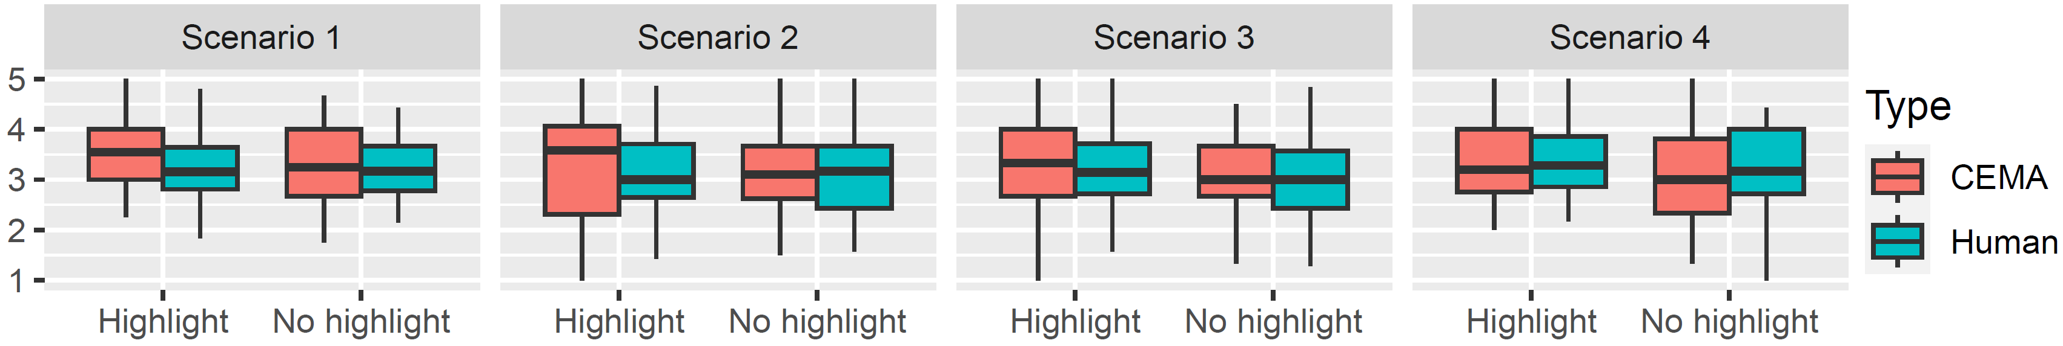
HUMAN EVALUATION
Independent variables:
Scenario (1 - 4)
Explanation type (CEMA/Human)
Highlighting CEMA (Y/N)
[4] Gyevnar, B., Wang, C., Lucas, C. G., Cohen, S. B., & Albrecht, S. V. (2024, May). Causal Explanations for Sequential Decision-Making in Multi-Agent Systems. 23rd International Conference on Autonomous Agents and Multi-Agent Systems (AAMAS). https://doi.org/10.48550/arXiv.2302.10809

Slide 89
BENEFITS
Generally applicable simple interactive framework;
No explicit assumption on causal structure:
No need to model world with DAGs;
Robust causal selection based on CESM;
Works for large number of agents:
  Tested with up to 20 agents in 4 scenarios.
[4] Gyevnar, B., Wang, C., Lucas, C. G., Cohen, S. B., & Albrecht, S. V. (2024, May). Causal Explanations for Sequential Decision-Making in Multi-Agent Systems. 23rd International Conference on Autonomous Agents and Multi-Agent Systems (AAMAS). https://doi.org/10.48550/arXiv.2302.10809

Slide 90
AGENDA
What are the fundamental problems with current explainable AI (XAI)?
  Motivation for XAI is misplaced;
  Standard methods are unreliable;
  XAI evaluation is unrevealing;
How to operationalise better explanations for AI-based decision-making?
  People explain all the time; study how they do it;
  Multi-agent systems (MAS);
  Causal Explanations for Sequential Decision-Making in MAS.

Slide 91
WHAT IS NEXT?
Better natural language generation;
More interactive evaluation;
Learning to explain with guarantees in MAS;
Explanations for more optimal planning in large MAS.

Slide 92
TAKEAWAYS
XAI does not live in a vacuum.
Ask yourself for whom, in what context, and how it is best to explain AI systems;
No such thing as improving trust.
Calibrate it according to the capabilities of the AI system;
Multi-agent systems are your friend.
They are ripe with tough-to-explain environments;
Ask your users how they would explain, then learn from them;
Causal explanations and natural language is effective.

Slide 93



ACKNOWLEDGEMENTS
My work would not have been possible without my supervisors:
Stefano Albrecht
Chris Lucas
Shay Cohen
And without my collaborators:
Cheng Wang
Massimiliano Tamborski
Nick Ferguson
Burkhard Schafer
Anton Kuznietsov
Stephanie Droop
Tadeg Quillien
Members of AARG

Slide 94

Thank you!
Read more about my work:
https://gbalint.me/
Autonomous Agents
Research Group

Slide 95
REFERENCES
[1] Quillien, T., & Lucas, C. G. (2023, June 8). Counterfactuals and the Logic of Causal Selection. Psychological Review. Advance online publication.
[2] Miller, T. (2023). Explainable AI is Dead, Long Live Explainable AI! Hypothesis-driven Decision Support using Evaluative AI. Proceedings of the 2023 ACM Conference on Fairness, Accountability, and Transparency, 333–342.
[3] Slack, D., Krishna, S., Lakkaraju, H., & Singh, S. (2023). Explaining machine learning models with interactive natural language conversations using TalkToModel. Nature Machine Intelligence, 5(8), Article 8.
[4] Gyevnar, B., Wang, C., Lucas, C. G., Cohen, S. B., & Albrecht, S. V. (2023). Causal Explanations for Sequential Decision-Making in Multi-Agent Systems. In The 23rd International Conference on Autonomous Agents and Multi-Agent Systems (AAMAS 2024).
[5] Gyevnar, B., Ferguson, N., & Schafer, B. (2023). Bridging the transparency gap: What can explainable AI learn from the AI Act? In Proceedings of ECAI 2023, the 26th European Conference on Artificial Intelligence (pp. 964 - 971).
[6] Rudin, C. (2019). Stop explaining black box machine learning models for high stakes decisions and use interpretable models instead. Nature Machine Intelligence, 1(5), Article 5
[7] Ustun, B., Spangher, A., & Liu, Y. (2019). Actionable Recourse in Linear Classification. Proceedings of the Conference on Fairness, Accountability, and Transparency, 10–19. [8] Schneeberger, D., Röttger, R., Cabitza, F., Campagner, A., Plass, M., Müller, H., & Holzinger, A. (2023). The Tower of Babel in Explainable Artificial Intelligence (XAI). In Machine Learning and Knowledge Extraction (pp. 65–81). Springer Nature Switzerland.

Slide 96
REFERENCES
[9] Fryer, D., Strümke, I., & Nguyen, H. (2021). Shapley Values for Feature Selection: The Good, the Bad, and the Axioms. IEEE Access, 9, 144352–144360.
[10] Adebayo, J., Gilmer, J., Muelly, M., Goodfellow, I., Hardt, M., & Kim, B. (2020). Sanity Checks for Saliency Maps (arXiv:1810.03292). arXiv.1810.03292.
[11]. Jalwana, M. A. A. K., Akhtar, N., Bennamoun, M., & Mian, A. (2021). CAMERAS: Enhanced Resolution And Sanity preserving Class Activation Mapping for image saliency. 2021 IEEE/CVF Conference on Computer Vision and Pattern Recognition (CVPR), 16322–16331.
[12] Jain, S., & Wallace, B. C. (2019). Attention is not Explanation. In J. Burstein, C. Doran, & T. Solorio (Eds.), Proceedings of the 2019 Conference of the North American Chapter of the Association for Computational Linguistics: Human Language Technologies, Volume 1 (Long and Short Papers) (pp. 3543–3556). Association for Computational Linguistics.
[13] Wiegreffe, S., & Pinter, Y. (2019). Attention is not not Explanation. In K. Inui, J. Jiang, V. Ng, & X. Wan (Eds.), Proceedings of the 2019 Conference on Empirical Methods in Natural Language Processing and the 9th International Joint Conference on Natural Language Processing (EMNLP-IJCNLP) (pp. 11–20). Association for Computational Linguistics.
[14] Leofante, F., & Potyka, N. (2024). Promoting Counterfactual Robustness through Diversity. Proceedings of the AAAI Conference on Artificial Intelligence, 38(19), Article 19.

Slide 97
REFERENCES
[15] Kuznietsov, A., Gyevnar, B., Wang, C., Peters, S., & Albrecht, S. V. (2024). Explainable AI for Safe and Trustworthy Autonomous Driving: A Systematic Review (arXiv:2402.10086). arXiv.
[16] Miller, T. (2022). Are we measuring trust correctly in explainability, interpretability, and transparency research? (arXiv:2209.00651). arXiv.
[17] Albrecht, S. V., Christianos, F., & Schäfer, L. (2024). Multi-agent reinforcement learning: Foundations and modern approaches. MIT Press.
[18] Gyevnar, B., Droop, S., & Quillien, T. (2024, March 11). People Attribute Purpose to Autonomous Vehicles When Explaining Their Behavior. (arXiv:2402.10086). arXiv.
[19] Miller, T. (2019). Explanation in artificial intelligence: Insights from the social sciences. Artificial Intelligence, 267, 1–38.
[20] Albrecht, S. V., Brewitt, C., Wilhelm, J., Gyevnar, B., Eiras, F., Dobre, M., & Ramamoorthy, S. (2021, March 15). Interpretable Goal-based Prediction and Planning for Autonomous Driving. IEEE International Conference on Robotics and Automation (ICRA)

